Slide 1
Quantum Error Correction: Stabiliser Codes
IQC Lecture 28, QEC Part II
Instructor: Joschka Roffe, joschka.roffe@ed.ac.uk

Slide 2
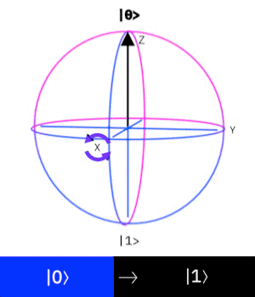
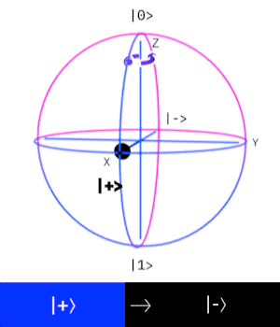
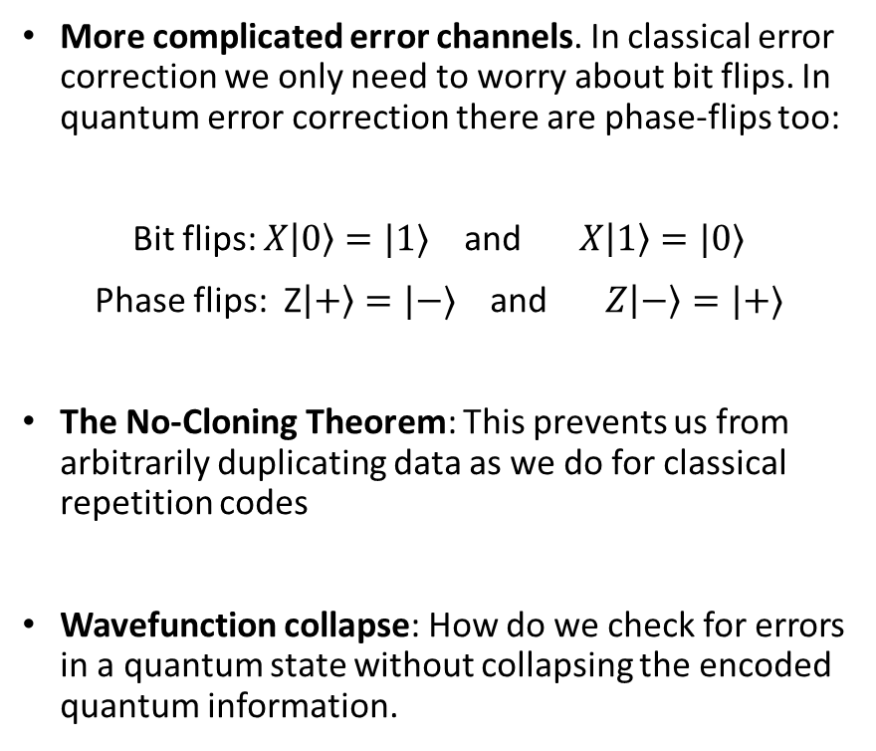
Recap: The Challenges of Quantum Error Correction
More complicated error channels. In classical error correction we only need to worry about bit flips. In quantum error correction there are phase-flips too:
Bit flips: $X\left|0\right\rangle =|1⟩$ and $X\left|1\right\rangle =|0⟩$
Phase flips: Z$\left|+\right\rangle =|−⟩$ and $Z\left|−\right\rangle =|+⟩$
The No-Cloning Theorem: This prevents us from arbitrarily duplicating data as we do for classical repetition codes
Wavefunction collapse: How do we check for errors in a quantum state without collapsing the encoded quantum information.
Evolution on the Bloch Sphere due to bit-flip (X-Pauli error)
Evolution on the Bloch Sphere due to phase-flip (Z-Pauli error)

Slide 3

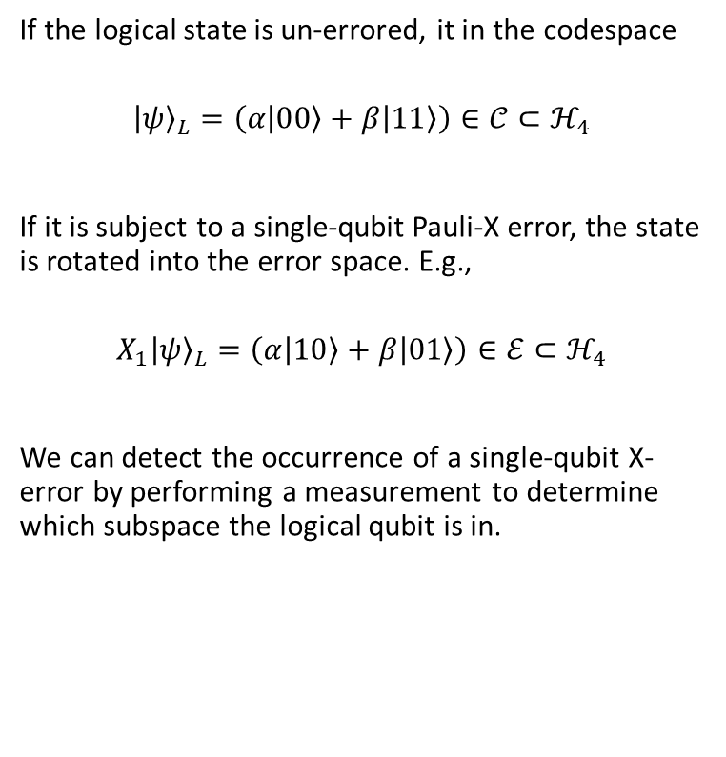





Recap: Subspace Encoding
If the logical state is un-errored, it in the codespace
$${\left|ψ\right\rangle }_{L}=\left(α\left|00\right\rangle +β\left|11\right\rangle \right)∈𝒞⊂ℋ_{4}$$
If it is subject to a single-qubit Pauli-X error, the state is rotated into the error space. E.g.,
$$X_{1}{\left|ψ\right\rangle }_{L}=\left(α\left|10\right\rangle +β\left|01\right\rangle \right)∈ℰ⊂ℋ_{4}$$
We can detect the occurrence of a single-qubit X-error by performing a measurement to determine which subspace the logical qubit is in.
$$𝒞:codespace$$
$$|00⟩$$
$$|11⟩$$
$$ℰ:errorspace$$
$$|10⟩$$
$$|01⟩$$

Slide 4
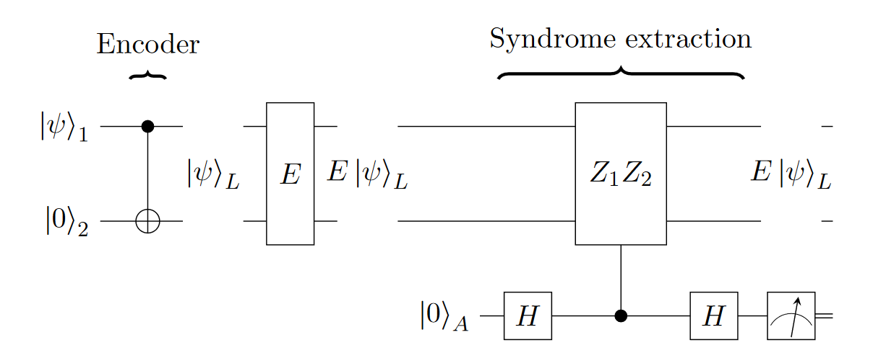
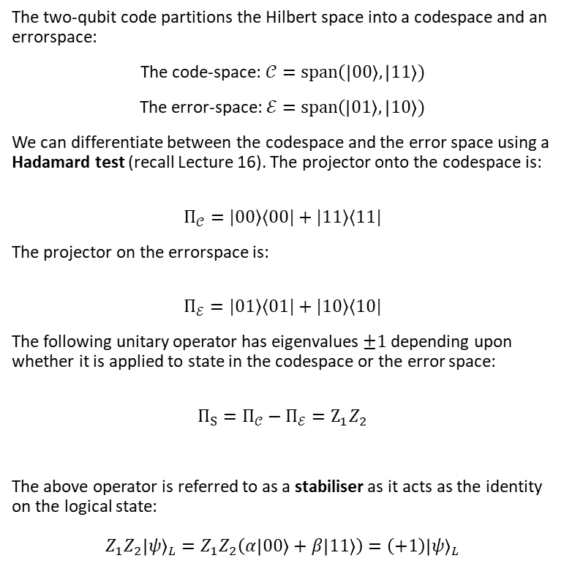
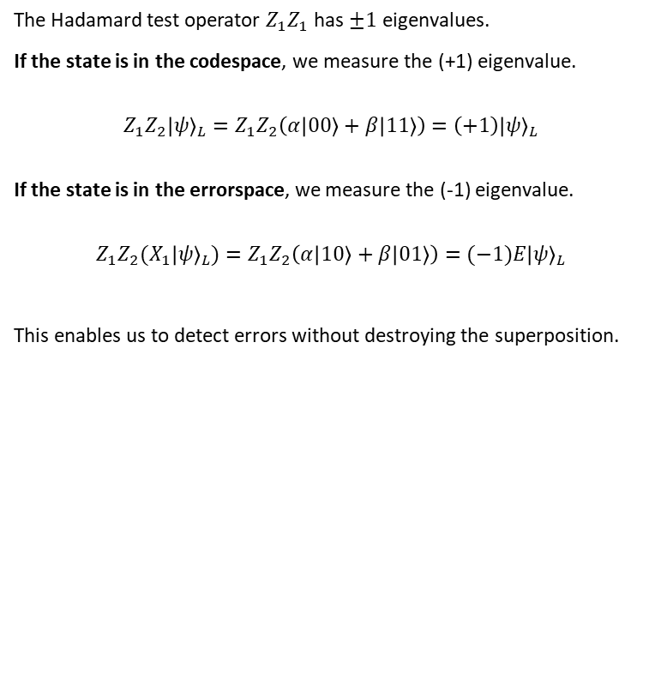
Recap: Detecting errors via stabiliser measurement
The two-qubit code partitions the Hilbert space into a codespace and an errorspace:
The code-space: $𝒞=span\left(\left|00\right\rangle , | 11\right\rangle )$
The error-space: $ℰ=$ $span\left(\left|01\right\rangle , | 10\right\rangle )$
We can differentiate between the codespace and the error space using a Hadamard test (recall Lecture 16). The projector onto the codespace is:
$$Π_{𝒞}=|00⟩⟨00|+|11⟩⟨11|$$
The projector on the errorspace is:
$$Π_{ℰ}=|01⟩⟨01|+|10⟩⟨10|$$
The following unitary operator has eigenvalues $±1$ depending upon whether it is applied to state in the codespace or the error space:
$$Π_{S}=Π_{𝒞}−Π_{ℰ}=Z_{1}Z_{2}$$
The above operator is referred to as a stabiliser as it acts as the identity on the logical state:
$$Z_{1}Z_{2}{\left|ψ\right\rangle }_{L}=Z_{1}Z_{2}\left(α\left|00\right\rangle +β\left|11\right\rangle \right)=\left(+1\right){\left|ψ\right\rangle }_{L}$$
The Hadamard test operator $Z_{1}Z_{1}$ has $±1$ eigenvalues.
If the state is in the codespace, we measure the (+1) eigenvalue.
$$Z_{1}Z_{2}{\left|ψ\right\rangle }_{L}=Z_{1}Z_{2}\left(α\left|00\right\rangle +β\left|11\right\rangle \right)=\left(+1\right){\left|ψ\right\rangle }_{L}$$ If the state is in the errorspace, we measure the (-1) eigenvalue.
$$Z_{1}Z_{2}{(X}_{1}{\left|ψ\right\rangle }_{L})=Z_{1}Z_{2}\left(α\left|10\right\rangle +β\left|01\right\rangle \right)=(−1){E\left|ψ\right\rangle }_{L}$$
This enables us to detect errors without destroying the superposition.

Slide 5
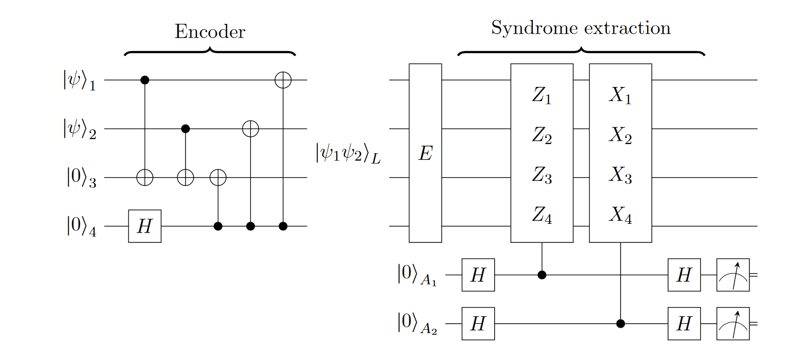
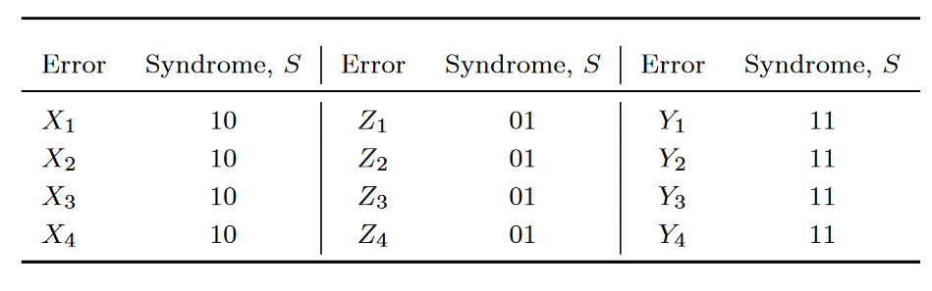
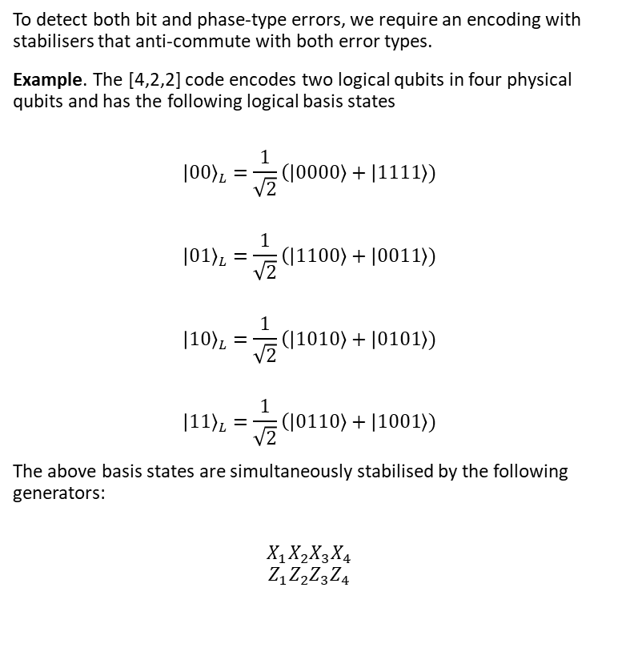
Recap: The [[4,2,2]] Detection Code
To detect both bit and phase-type errors, we require an encoding with stabilisers that anti-commute with both error types.
Example. The [4,2,2] code encodes two logical qubits in four physical qubits and has the following logical basis states
$${\left|00\right\rangle }_{L}=\frac{1}{\sqrt{2}}\left(\left|0000\right\rangle + | 1111\right\rangle )$$
$${\left|01\right\rangle }_{L}=\frac{1}{\sqrt{2}}\left(\left|1100\right\rangle + | 0011\right\rangle )$$
$${\left|10\right\rangle }_{L}=\frac{1}{\sqrt{2}}\left(\left|1010\right\rangle + | 0101\right\rangle )$$
$${\left|11\right\rangle }_{L}=\frac{1}{\sqrt{2}}\left(\left|0110\right\rangle + | 1001\right\rangle )$$
The above basis states are simultaneously stabilised by the following generators:
$$X_{1}X_{2}X_{3}X_{4}$$
$$Z_{1}Z_{2}Z_{3}Z_{4}$$
The syndrome table for the [4,2,2] detection code. Each single-qubit X/Y/Z error yields a non-zero syndrome. However, some syndromes are shared. -> This is a detection code not a correction code.

Slide 6
The Stabiliser Formalism for Quantum Error Correction

Slide 7
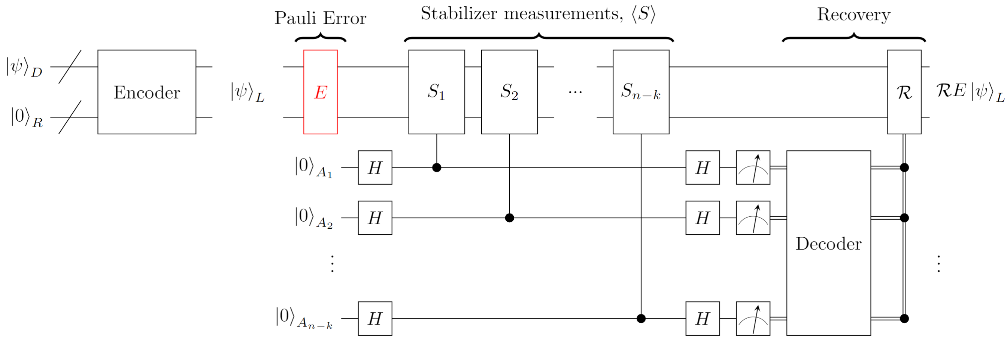
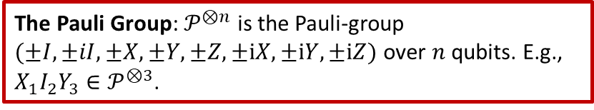
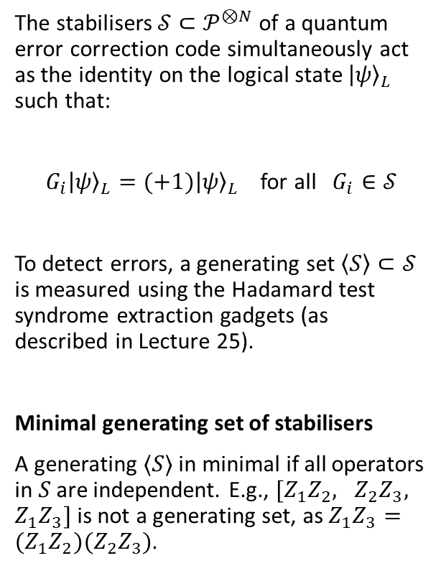
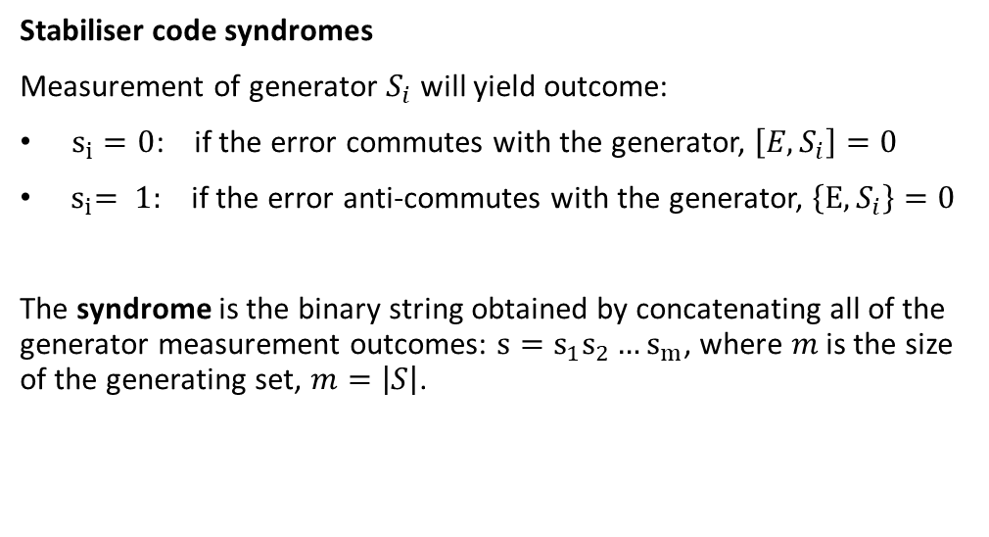
The Pauli Group: $𝒫^{⊗n}$ is the Pauli-group $(±I,±iI, ±X,±Y,±Z,±iX,±iY,±iZ)$ over $n$ qubits. E.g., $X_{1}I_{2}Y_{3}∈𝒫^{⊗3}$.
Stabiliser Codes
The stabilisers $𝒮⊂𝒫^{⊗N}$ of a quantum error correction code simultaneously act as the identity on the logical state ${\left|ψ\right\rangle }_{L}$ such that:
$G_{i}{\left|ψ\right\rangle }_{L}=(+1){\left|ψ\right\rangle }_{L}$ for all $G_{i}∈𝒮$
To detect errors, a generating set $\left\langle S\right\rangle ⊂𝒮$ is measured using the Hadamard test syndrome extraction gadgets (as described in Lecture 25).
Minimal generating set of stabilisers
A generating $⟨S⟩$ in minimal if all operators in $S$ are independent. E.g., $[Z_{1}Z_{2}, Z_{2}Z_{3}, Z_{1}Z_{3}]$ is not a generating set, as $Z_{1}Z_{3}={(Z}_{1}Z_{2})(Z_{2}Z_{3})$.
Stabiliser code syndromes
Measurement of generator $S_{i}$ will yield outcome:
$s_{i}=0$: if the error commutes with the generator, $\left[E,S_{i}\right]=0$
${ s}_{i}= 1:$ if the error anti-commutes with the generator, $\left\{E,S_{i}\right\}=0$
The syndrome is the binary string obtained by concatenating all of the generator measurement outcomes: $s=s_{1}s_{2}…s_{m}$, where $m$ is the size of the generating set, $m=\left|S\right|$.

Slide 8
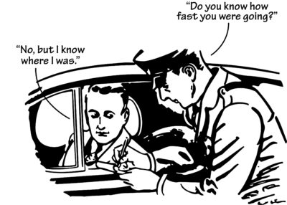
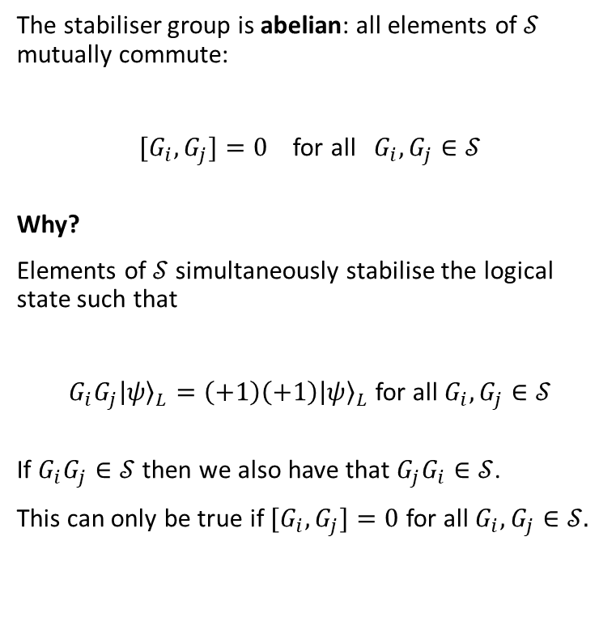
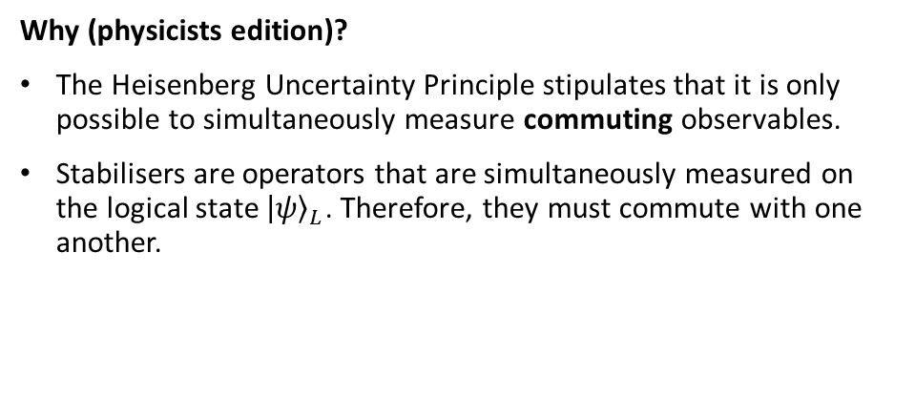
The Stabiliser Group is Abelian
The stabiliser group is abelian: all elements of $𝒮$ mutually commute:
${[G}_{i}, G_{j}]=0$ for all $G_{i},G_{j}∈𝒮$
Why?
Elements of $𝒮$ simultaneously stabilise the logical state such that
$G_{i}G_{j}{\left|ψ\right\rangle }_{L}=\left(+1\right)\left(+1\right){\left|ψ\right\rangle }_{L}$ for all $G_{i},G_{j}∈𝒮$
If $G_{i}G_{j}∈𝒮$ then we also have that $G_{j}G_{i}∈𝒮$.
This can only be true if ${[G}_{i}, G_{j}]=0$ for all $G_{i},G_{j}∈𝒮.$
Why (physicists edition)?
The Heisenberg Uncertainty Principle stipulates that it is only possible to simultaneously measure commuting observables.
Stabilisers are operators that are simultaneously measured on the logical state ${\left|ψ\right\rangle }_{L}$. Therefore, they must commute with one another.

Slide 9
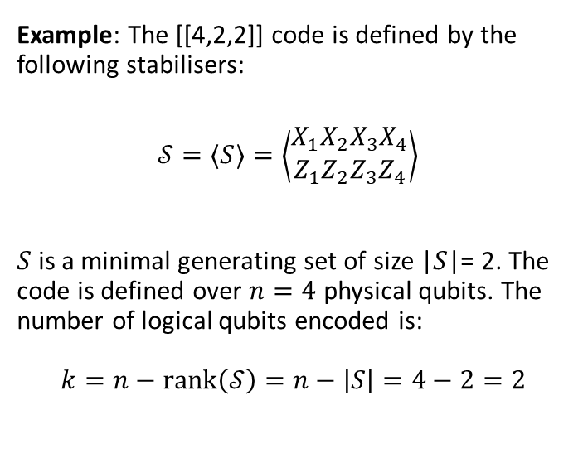
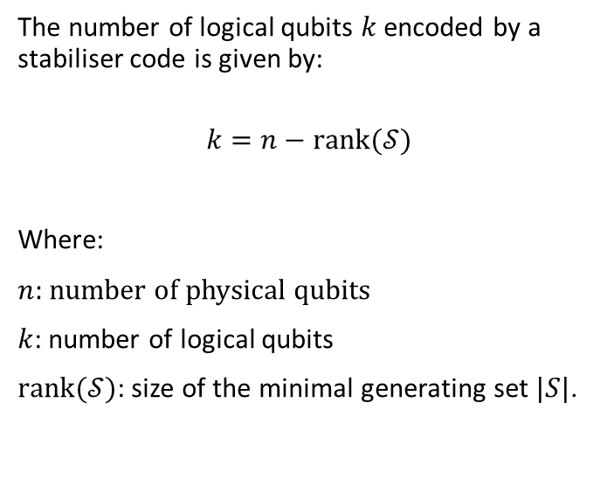
Logical qubit count
The number of logical qubits $k$ encoded by a stabiliser code is given by:
$$k=n−rank(𝒮)$$
Where:
$n$: number of physical qubits
$k$: number of logical qubits
$rank(𝒮)$: size of the minimal generating set $|S|$.
Example: The [[4,2,2]] code is defined by the following stabilisers:
$$𝒮=⟨S⟩=\left\langle \left.\begin{matrix}X_{1}X_{2}X_{3}X_{4} \\ Z_{1}Z_{2}Z_{3}Z_{4}\end{matrix}\right\rangle \right.$$
$S$ is a minimal generating set of size |$S$|= 2. The code is defined over $n=4$ physical qubits. The number of logical qubits encoded is: $$k=n−rank\left(𝒮\right)=n−\left|S\right|=4−2=2$$

Slide 10
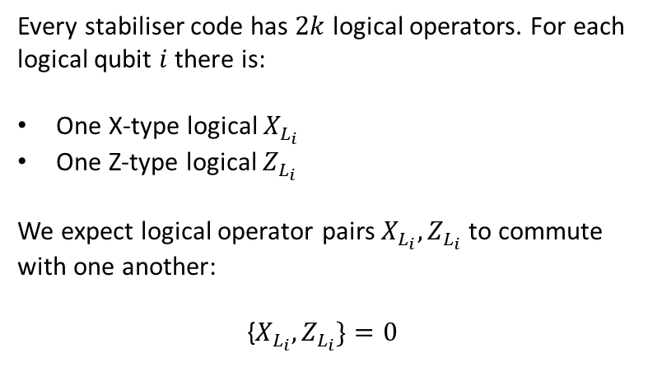
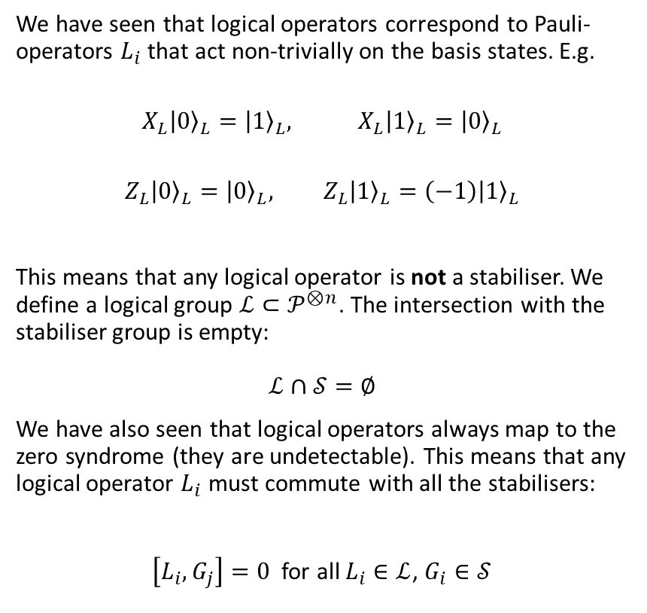
Properties of logical operators
We have seen that logical operators correspond to Pauli-operators $L_{i}$ that act non-trivially on the basis states. E.g.
$$X_{L}{\left|0\right\rangle }_{L}={\left|1\right\rangle }_{L}, X_{L}{\left|1\right\rangle }_{L}={\left|0\right\rangle }_{L}$$
$$Z_{L}{\left|0\right\rangle }_{L}={\left|0\right\rangle }_{L}, Z_{L}{\left|1\right\rangle }_{L}=\left(−1\right){\left|1\right\rangle }_{L}$$
This means that any logical operator is not a stabiliser. We define a logical group $ℒ⊂𝒫^{⊗n}$. The intersection with the stabiliser group is empty: $$ℒ∩𝒮=∅$$
We have also seen that logical operators always map to the zero syndrome (they are undetectable). This means that any logical operator $L_{i}$ must commute with all the stabilisers:
$\left[L_{i},G_{j}\right]=0$ for all $L_{i}∈ℒ$, $G_{i}∈𝒮$
Every stabiliser code has $2k$ logical operators. For each logical qubit $i$ there is:
One X-type logical $X_{L_{i}}$
One Z-type logical $Z_{L_{i}}$
We expect logical operator pairs $X_{L_{i}},Z_{L_{i}}$ to commute with one another:
{$X_{L_{i}},Z_{L_{i}}\}=0$

Slide 11
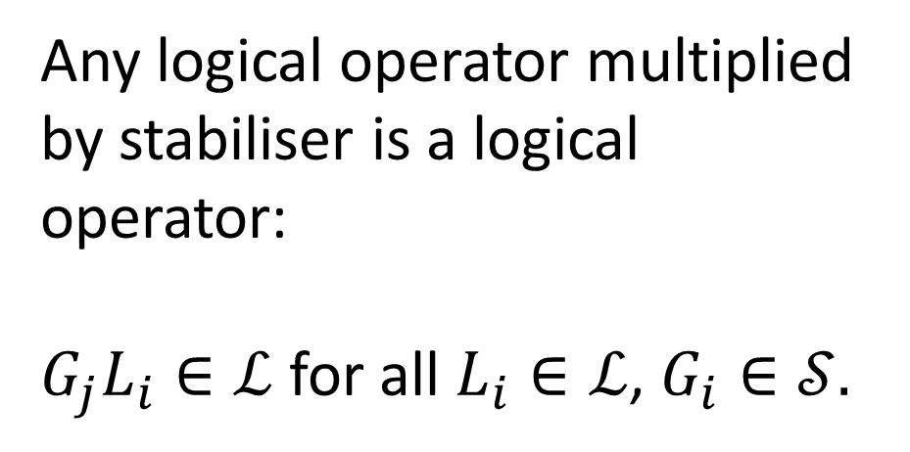
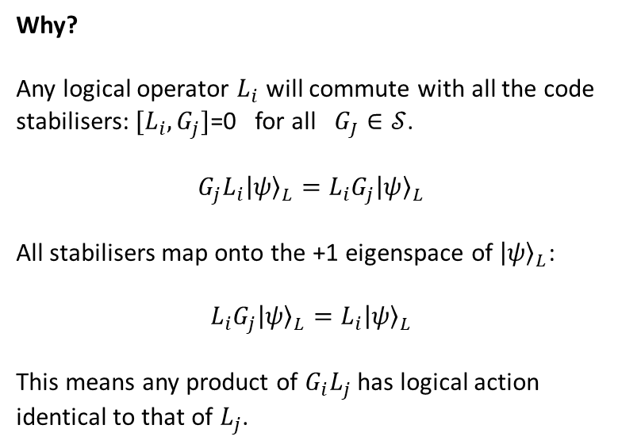
Properties of Logical Operators Continued
Any logical operator multiplied by stabiliser is a logical operator:
${G_{j}L}_{i}∈ℒ$ for all $L_{i}∈ℒ$, $G_{i}∈𝒮.$
Why?
Any logical operator $L_{i}$ will commute with all the code stabilisers: $[L_{i},G_{j}]$=0 for all $G_{J}∈𝒮$.
$$G_{j}L_{i}{\left|ψ\right\rangle }_{L}=L_{i}G_{j}{\left|ψ\right\rangle }_{L}$$
All stabilisers map onto the +1 eigenspace of ${\left|ψ\right\rangle }_{L}$: $$L_{i}G_{j}{\left|ψ\right\rangle }_{L}=L_{i}{\left|ψ\right\rangle }_{L}$$
This means any product of $G_{i}L_{j}$ has logical action identical to that of $L_{j}$.

Slide 12
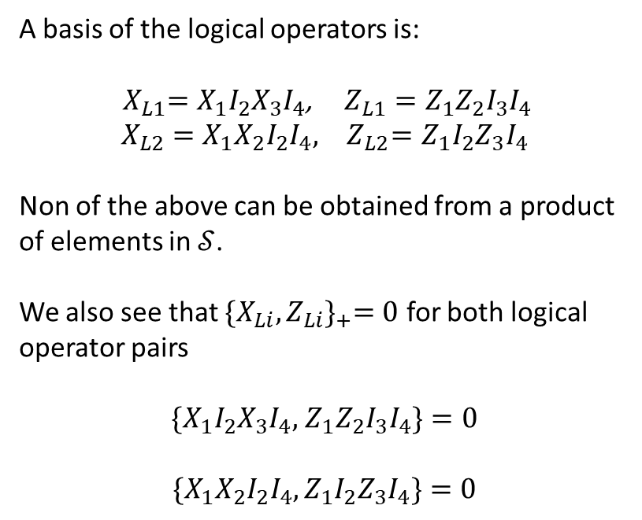
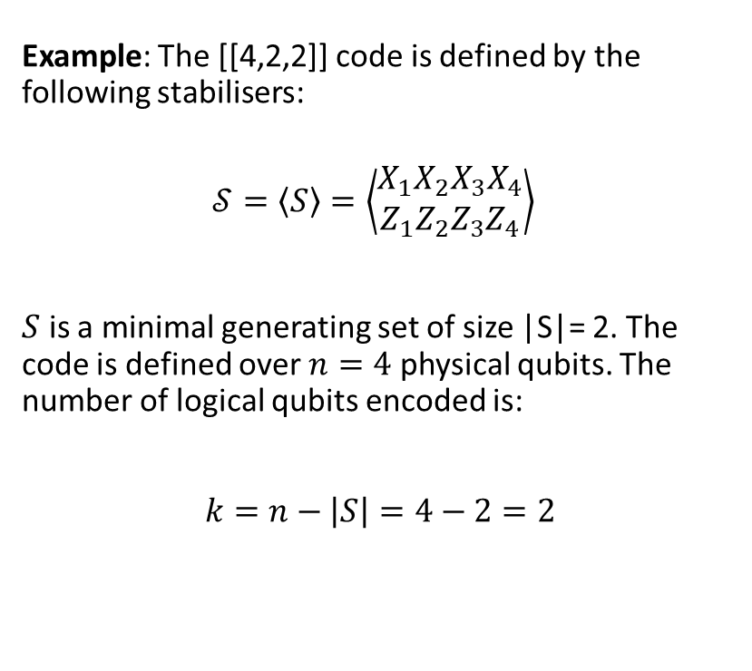
Example: Logical Operators of the [[4,2,2]] Code
Example: The [[4,2,2]] code is defined by the following stabilisers:
$$𝒮=\left\langle S\right\rangle =\left\langle \left.\begin{matrix}X_{1}X_{2}X_{3}X_{4} \\ Z_{1}Z_{2}Z_{3}Z_{4}\end{matrix}\right\rangle \right.$$
$S$ is a minimal generating set of size |S|= 2. The code is defined over $n=4$ physical qubits. The number of logical qubits encoded is:
$$k=n−\left|S\right|=4−2=2$$
A basis of the logical operators is:
${ X}_{L1}=X_{1}I_{2}X_{3}I_{4}$, $Z_{L1}=Z_{1}Z_{2}I_{3}I_{4}$
$$X_{L2}=X_{1}X_{2}I_{2}I_{4}, { Z}_{L2}=Z_{1}I_{2}Z_{3}I_{4}$$
Non of the above can be obtained from a product of elements in $𝒮$.
We also see that ${\{X_{Li},Z_{Li}\}}_{+}=0$ for both logical operator pairs
$\{X_{1}I_{2}X_{3}I_{4},$ $Z_{1}Z_{2}I_{3}I_{4}\}=0$
$${\{X}_{1}X_{2}I_{2}I_{4},Z_{1}I_{2}Z_{3}I_{4}\}=0$$

Slide 13
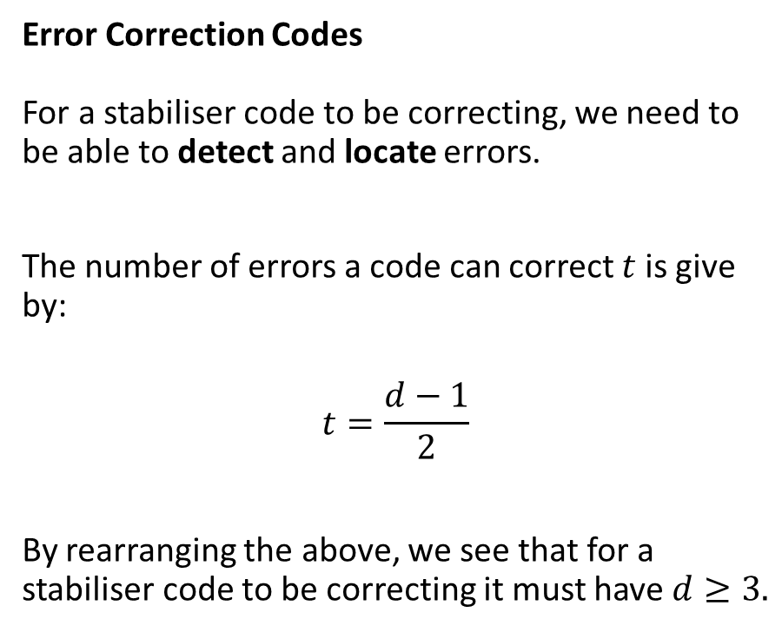
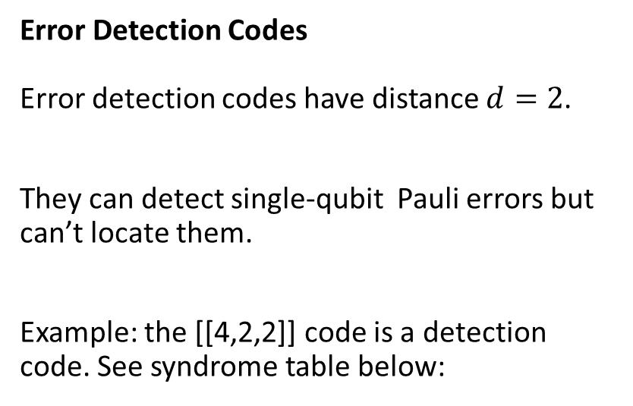
Designing Quantum Error Correction Codes
Error Detection Codes Error detection codes have distance $d=2$.
They can detect single-qubit Pauli errors but can’t locate them.
Example: the [[4,2,2]] code is a detection code. See syndrome table below:
Error Correction Codes For a stabiliser code to be correcting, we need to be able to detect and locate errors.
The number of errors a code can correct $t$ is give by:
$$t=\frac{d−1}{2}$$
By rearranging the above, we see that for a stabiliser code to be correcting it must have $d≥3.$

Slide 14
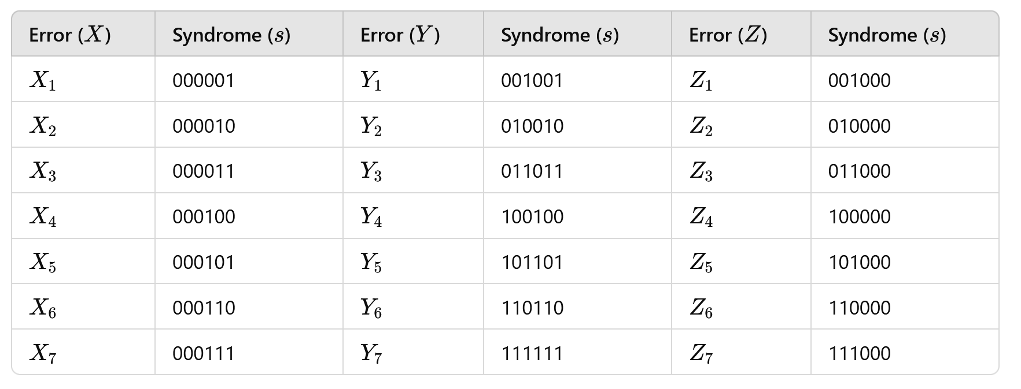
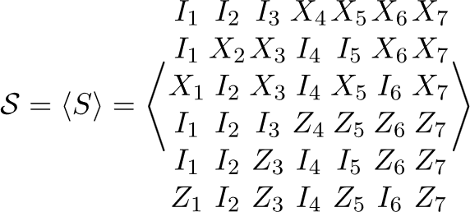

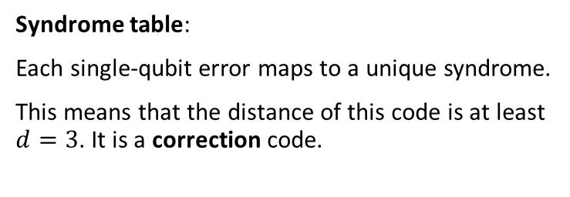
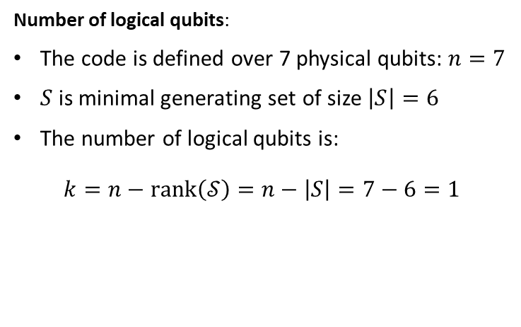
Example: The Steane Code
The Steane code is defined by the following stabiliser group generated by the stabilisers $S$:
Number of logical qubits:
The code is defined over 7 physical qubits: $n=7$
$S$ is minimal generating set of size $\left|S\right|=6$
The number of logical qubits is:
$$k=n−rank\left(𝒮\right)=n−\left|S\right|=7−6=1$$
Syndrome table:
Each single-qubit error maps to a unique syndrome.
This means that the distance of this code is at least $d=3$. It is a correction code.

Slide 15
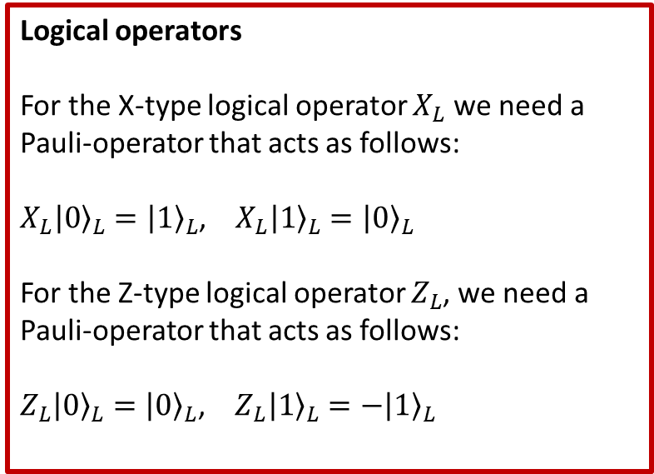
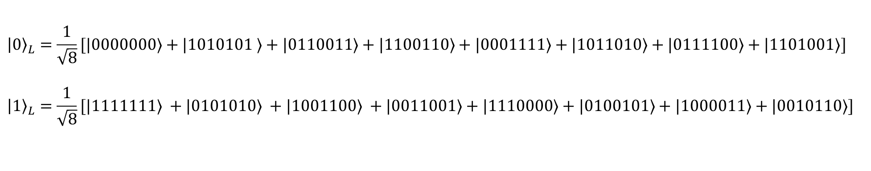
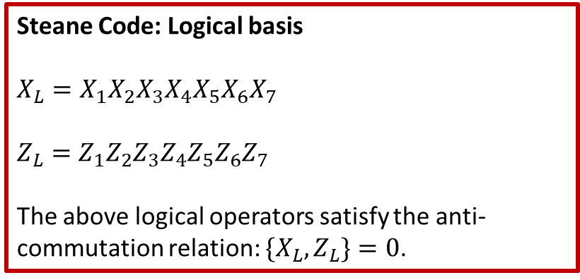
The Steane Code: Logical Operators
$${\left|0\right\rangle }_{L}=\frac{1}{\sqrt{8}}[|0000000⟩+|1010101 ⟩+|0110011⟩+|1100110⟩+|0001111⟩+|1011010⟩+|0111100⟩+|1101001⟩]$$
$${\left|1\right\rangle }_{L}=\frac{1}{\sqrt{8}}[|1111111⟩ +|0101010⟩ +|1001100⟩ +|0011001⟩+|1110000⟩+|0100101⟩+|1000011⟩+|0010110⟩]$$
Logical operators
For the X-type logical operator $X_{L}$ we need a Pauli-operator that acts as follows:
$X_{L}{\left|0\right\rangle }_{L}={\left|1\right\rangle }_{L}$, $X_{L}{\left|1\right\rangle }_{L}={\left|0\right\rangle }_{L}$
For the Z-type logical operator $Z_{L}$, we need a Pauli-operator that acts as follows:
$Z_{L}{\left|0\right\rangle }_{L}={\left|0\right\rangle }_{L}$, $Z_{L}{\left|1\right\rangle }_{L}={−\left|1\right\rangle }_{L}$
Steane Code: Logical basis $$X_{L}=X_{1}X_{2}X_{3}X_{4}X_{5}X_{6}X_{7}$$
$$Z_{L}=Z_{1}Z_{2}Z_{3}Z_{4}Z_{5}Z_{6}Z_{7}$$
The above logical operators satisfy the anti-commutation relation: $\{X_{L},Z_{L}\}=0$.

Slide 16
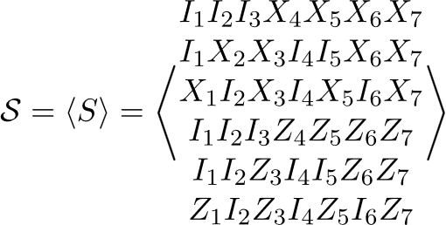
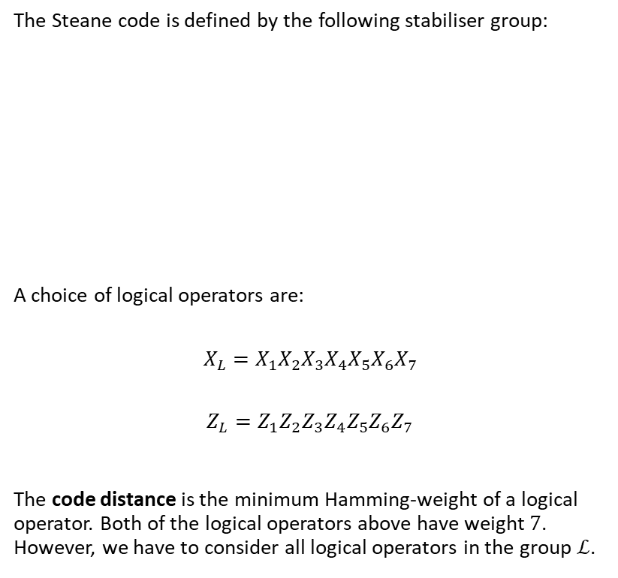
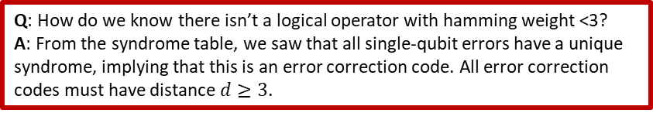
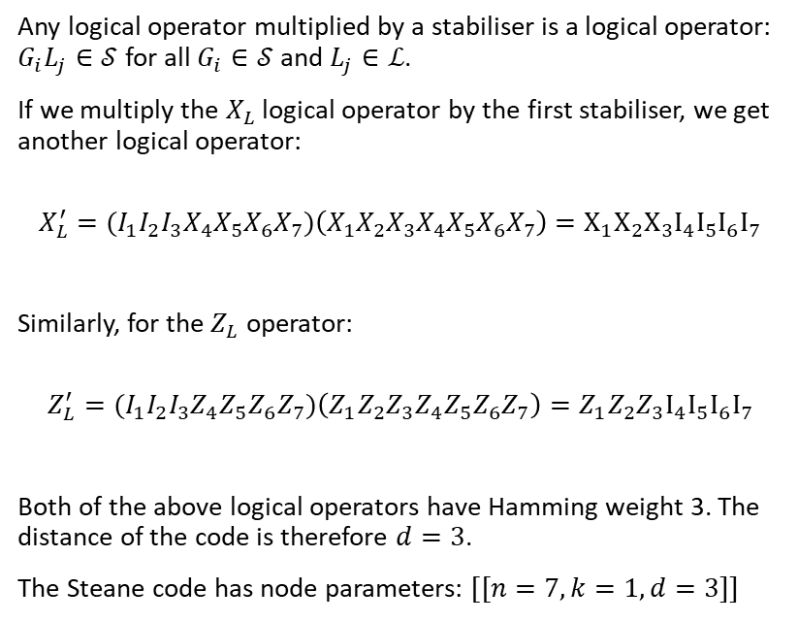
Q: How do we know there isn’t a logical operator with hamming weight <3?
A: From the syndrome table, we saw that all single-qubit errors have a unique syndrome, implying that this is an error correction code. All error correction codes must have distance $d≥3$.
Steane Code: Distance
The Steane code is defined by the following stabiliser group:
A choice of logical operators are:
$$X_{L}=X_{1}X_{2}X_{3}X_{4}X_{5}X_{6}X_{7}$$
$$Z_{L}=Z_{1}Z_{2}Z_{3}Z_{4}Z_{5}Z_{6}Z_{7}$$
The code distance is the minimum Hamming-weight of a logical operator. Both of the logical operators above have weight $7$. However, we have to consider all logical operators in the group $ℒ$.
Any logical operator multiplied by a stabiliser is a logical operator: $G_{i}L_{j}∈𝒮$ for all $G_{i}∈𝒮$ and $L_{j}∈ℒ$.
If we multiply the $X_{L}$ logical operator by the first stabiliser, we get another logical operator:
$${X_{L}^{′}=(I}_{1}I_{2}I_{3}X_{4}X_{5}X_{6}X_{7})\left(X_{1}X_{2}X_{3}X_{4}X_{5}X_{6}X_{7}\right)=X_{1}X_{2}X_{3}I_{4}I_{5}I_{6}I_{7}$$
Similarly, for the $Z_{L}$ operator:
$${Z_{L}^{′}=(I}_{1}I_{2}I_{3}Z_{4}Z_{5}Z_{6}Z_{7})\left(Z_{1}Z_{2}Z_{3}Z_{4}Z_{5}Z_{6}Z_{7}\right)=Z_{1}Z_{2}Z_{3}I_{4}I_{5}I_{6}I_{7}$$
Both of the above logical operators have Hamming weight 3. The distance of the code is therefore $d=3$.
The Steane code has node parameters: $[[n=7, k=1, d=3]]$

Slide 17
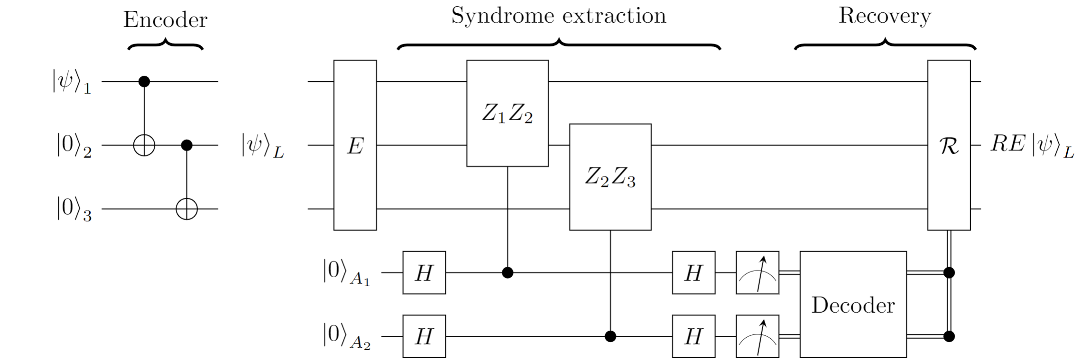
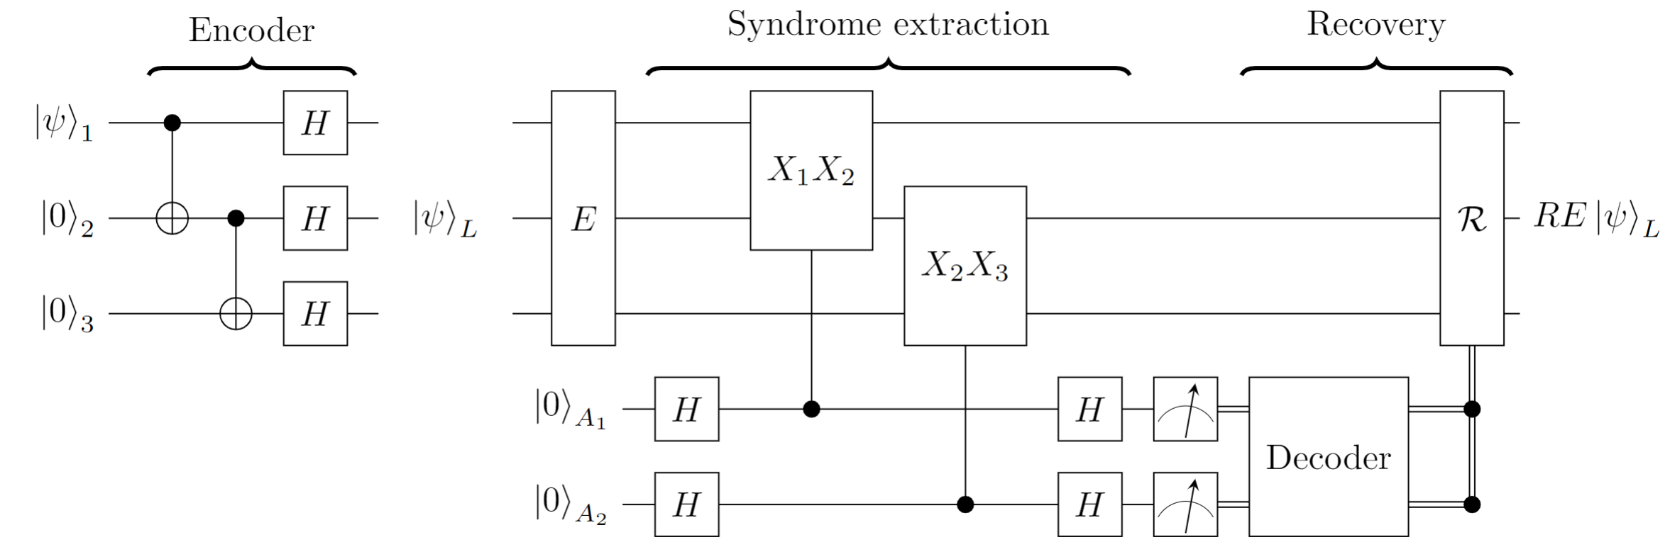
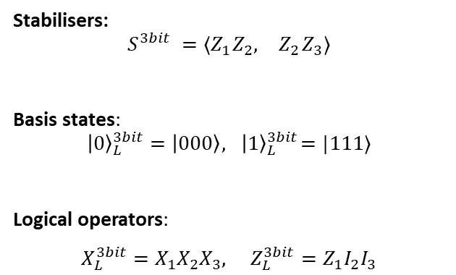
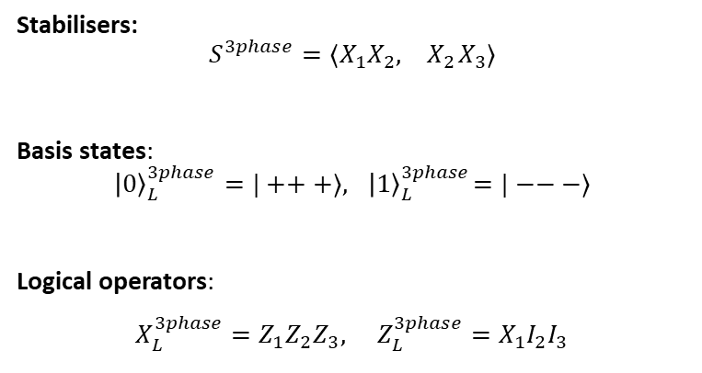
The Shor Code: Code Construction by Concatenation
Code concatenation is a method of creating a larger code from two copies of a smaller code. The [[9,1,3]] code is a simple example that is obtained by concatenating a 3-bit repetition code for phase flips with a 3-qubit repition code for bit-flips.
3-qubit code for bit-flips
3-qubit code for phase-flips
Stabilisers:
$$S^{3bit} ={⟨Z}_{1}Z_{2}, { Z}_{2}Z_{3}⟩$$
Basis states:
$${\left|0\right\rangle }_{L}^{3bit}=\left|000\right\rangle , { \left|1\right\rangle }_{L}^{3bit}=|111⟩$$
Logical operators:
$X_{L}^{3bit}=X_{1}X_{2}X_{3}, Z_{L}^{3bit}=Z_{1}I_{2}I_{3}$
Stabilisers:
$$S^{3phase}={⟨X}_{1}X_{2}, { X}_{2}X_{3}⟩$$
Basis states:
$${\left|0\right\rangle }_{L}^{3phase}=|+++⟩, { \left|1\right\rangle }_{L}^{3phase}=|−−−⟩$$
Logical operators:
$X_{L}^{3phase}=Z_{1}Z_{2}Z_{3}, Z_{L}^{3phase}=X_{1}I_{2}I_{3}$

Slide 18
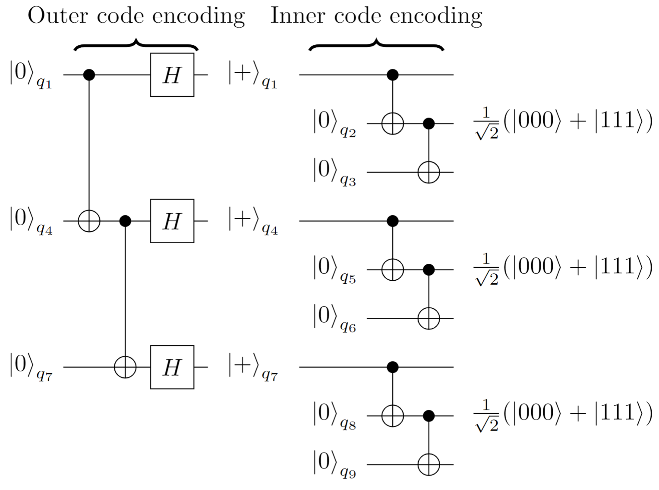
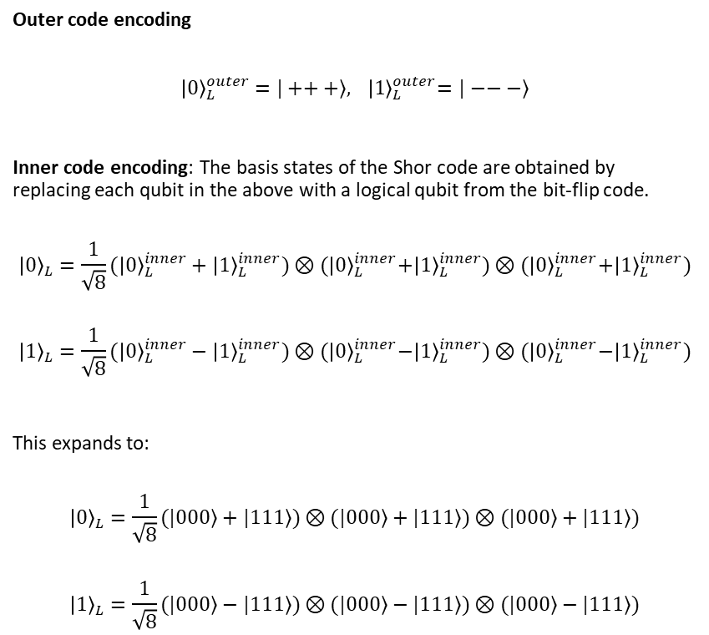
Shor Code: Encoding via Concatenation
Outer code encoding
$${\left|0\right\rangle }_{L}^{outer}=|+++⟩, { \left|1\right\rangle }_{L}^{outer}=|−−−⟩$$
Inner code encoding: The basis states of the Shor code are obtained by replacing each qubit in the above with a logical qubit from the bit-flip code.
$${\left|0\right\rangle }_{L}={\frac{1}{\sqrt{8}}(\left|0\right\rangle }_{L}^{inner}+{\left|1\right\rangle }_{L}^{inner})⊗{(\left|0\right\rangle }_{L}^{inner}+{\left|1\right\rangle }_{L}^{inner})⊗{(\left|0\right\rangle }_{L}^{inner}+{\left|1\right\rangle }_{L}^{inner})$$
$${\left|1\right\rangle }_{L}={\frac{1}{\sqrt{8}}(\left|0\right\rangle }_{L}^{inner}−{\left|1\right\rangle }_{L}^{inner})⊗{(\left|0\right\rangle }_{L}^{inner}−{\left|1\right\rangle }_{L}^{inner})⊗{(\left|0\right\rangle }_{L}^{inner}−{\left|1\right\rangle }_{L}^{inner})$$
This expands to:
$${\left|0\right\rangle }_{L}=\frac{1}{\sqrt{8}}(|000⟩+|111⟩)⊗(|000⟩+|111⟩)⊗(|000⟩+|111⟩)$$
$${\left|1\right\rangle }_{L}=\frac{1}{\sqrt{8}}(|000⟩−|111⟩)⊗(|000⟩−|111⟩)⊗(|000⟩−|111⟩)$$

Slide 19
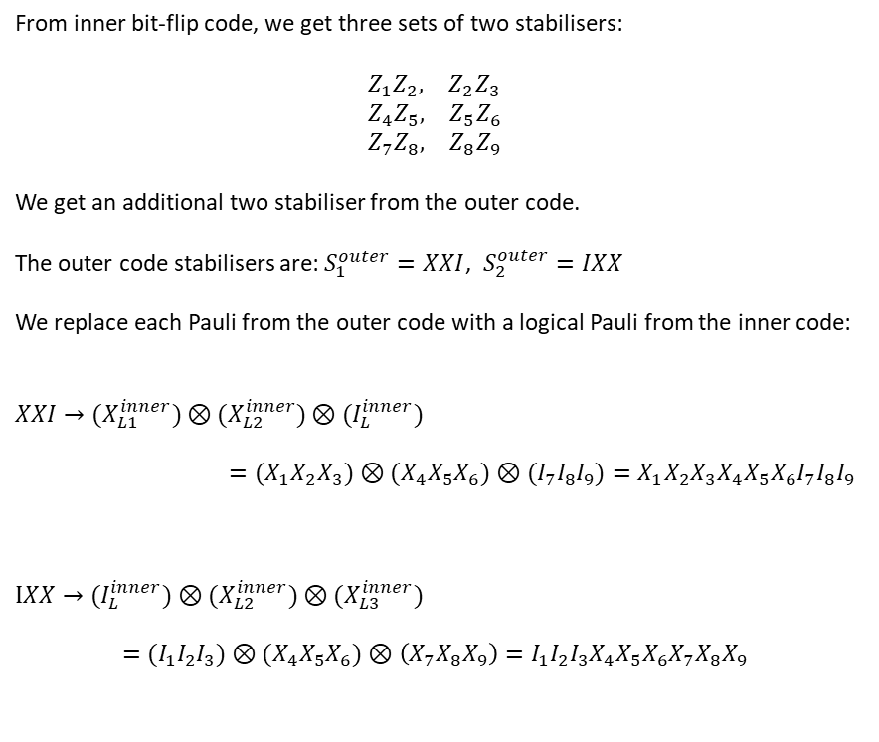
Shor Code Stabilisers
From inner bit-flip code, we get three sets of two stabilisers: $$Z_{1}Z_{2}, { Z}_{2}Z_{3} \\ Z_{4}Z_{5}, { Z}_{5}Z_{6} \\ Z_{7}Z_{8}, { Z}_{8}Z_{9}$$
We get an additional two stabiliser from the outer code.
The outer code stabilisers are: $S_{1}^{outer}=XXI$, $S_{2}^{outer}=IXX$
We replace each Pauli from the outer code with a logical Pauli from the inner code:
$${XXI→(X}_{L1}^{inner}{)⊗(X}_{L2}^{inner})⊗(I_{L}^{inner})$$
$$={(X}_{1}X_{2}X_{3})⊗(X_{4}X_{5}X_{6})⊗{(I}_{7}I_{8}I_{9})=X_{1}X_{2}X_{3}X_{4}X_{5}X_{6}I_{7}I_{8}I_{9}$$
$$IXX→{(I}_{L}^{inner})⊗{(X}_{L2}^{inner}{)⊗(X}_{L3}^{inner})$$
$$={{(I}_{1}I_{2}I_{3})⊗(X}_{4}X_{5}X_{6})⊗\left(X_{7}X_{8}X_{9}\right)={I_{1}I_{2}I_{3}X}_{4}X_{5}X_{6}X_{7}X_{8}X_{9}$$

Slide 20
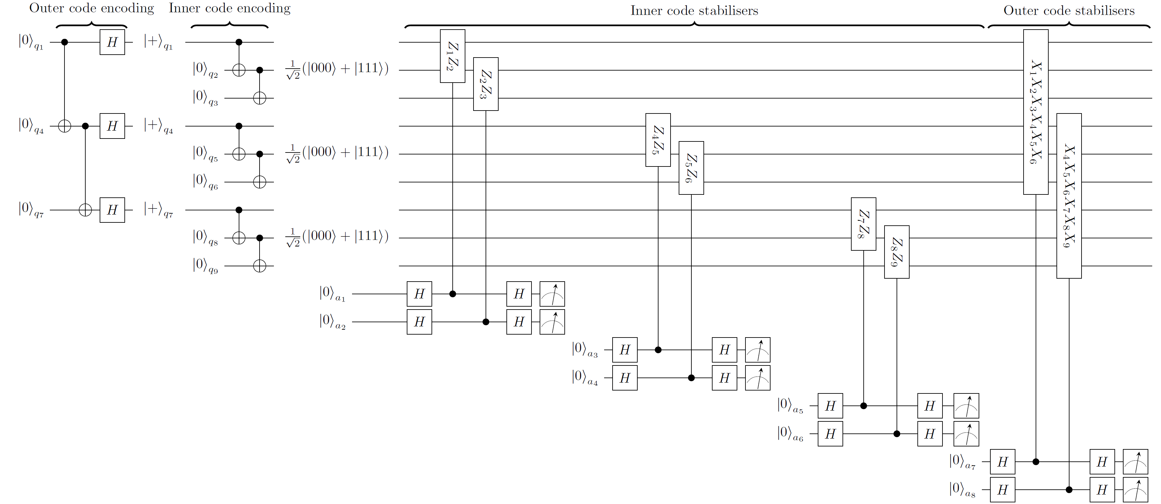
Shor Code Stabilisers

Slide 21
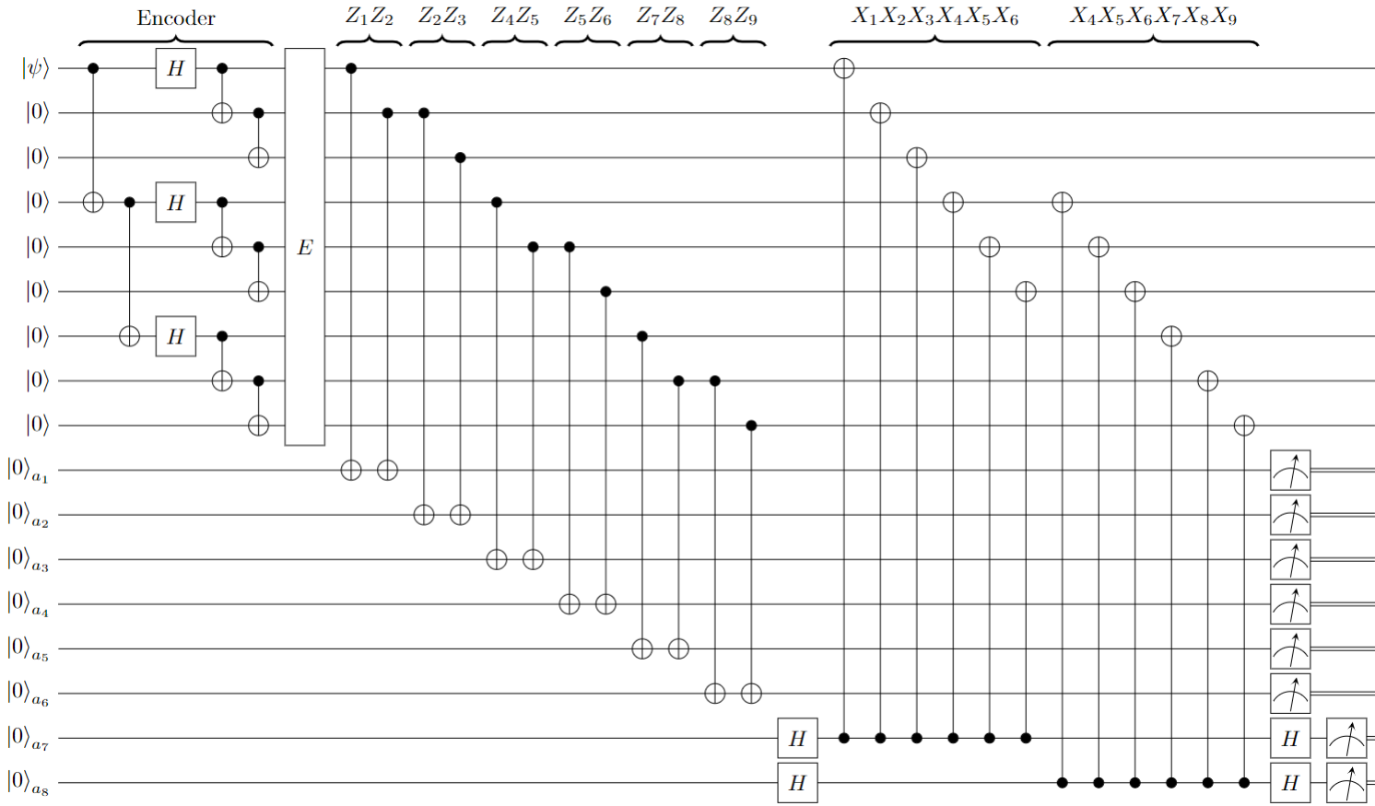
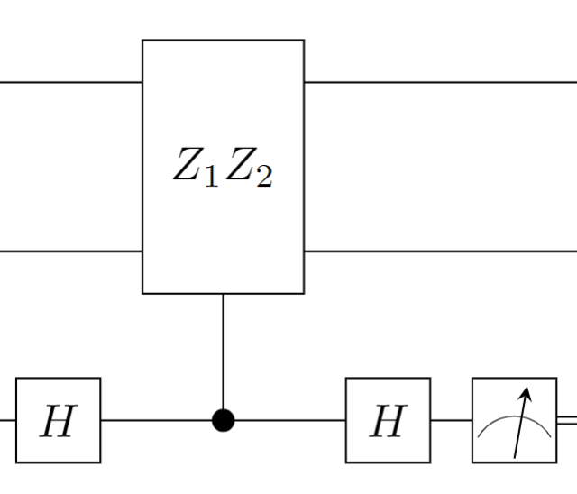
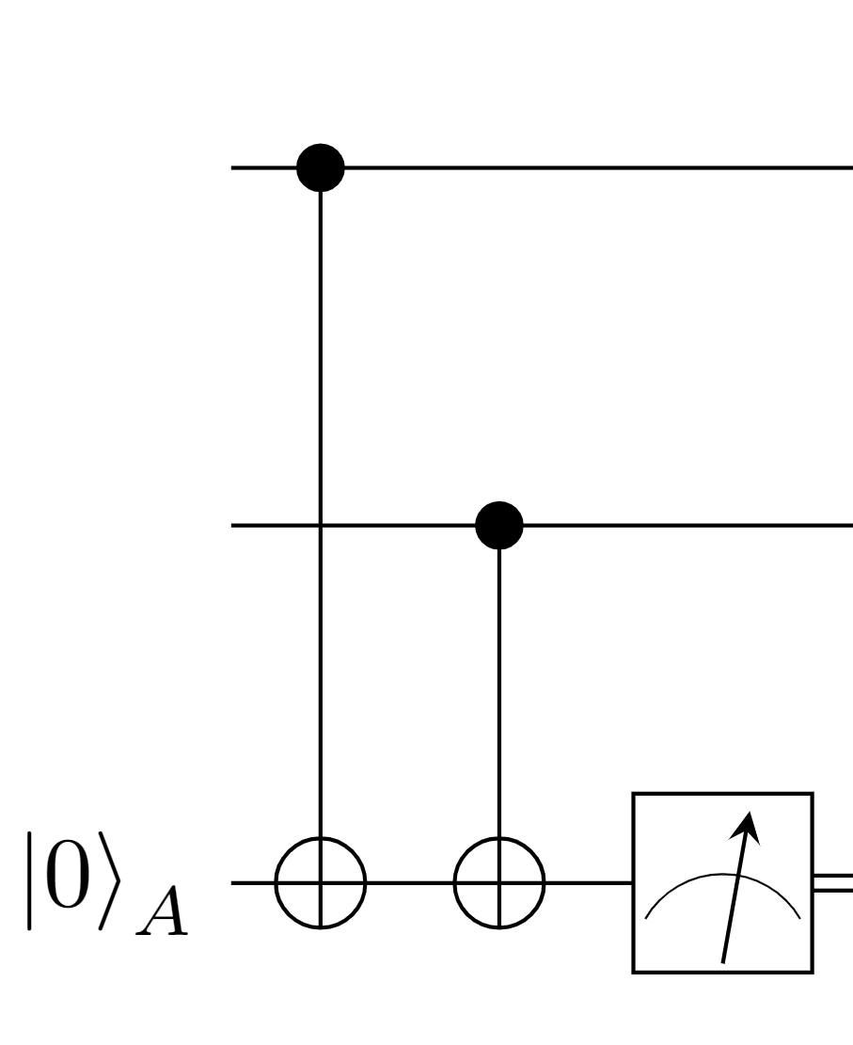
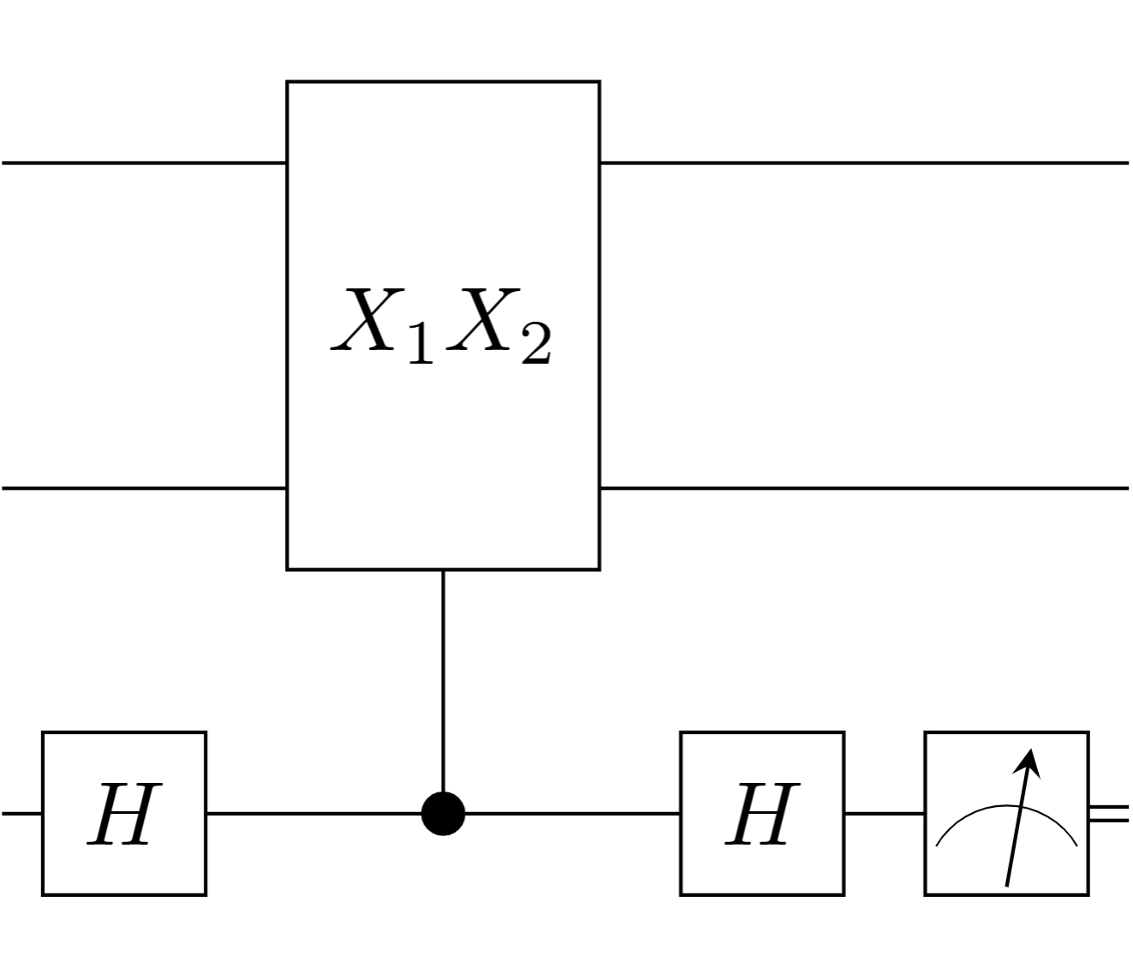

Shor [[9,1,3]] Code Circuit
Compiling stabiliser checks with CNOT gates
=
=

Slide 22




Shor Code: Logical Operators and Distance
$${\left|0\right\rangle }_{L}=\frac{1}{\sqrt{8}}(|000⟩+|111⟩)⊗(|000⟩+|111⟩)⊗(|000⟩+|111⟩)$$
$${\left|1\right\rangle }_{L}=\frac{1}{\sqrt{8}}(|000⟩−|111⟩)⊗(|000⟩−|111⟩)⊗(|000⟩−|111⟩)$$
Outer code logical operators:
$$X_{L}^{outer}=ZZZ$$
$Z_{L}^{outer}=XII$
Inner code logical operators:
$$X_{L}^{inner}=XXX$$
$$Z_{L}^{inner}=ZII$$
To get the Shor code logical operators, we replace each Pauli in the outer code with a logical Pauli from the inner code
$$Z_{L}^{outer}=XII → X_{L}^{inner}⊗I_{L}^{inner}⊗I_{L}^{inner}=X_{1}X_{2}X_{3}I_{4}I_{5}I_{6}I_{7}I_{8}I_{9}$$
$$X_{L}^{outer}=ZZZ →(Z_{L}^{inner})⊗\left(Z_{L}^{inner}\right)⊗(Z_{L}^{inner})=Z_{1}I_{2}I_{3}Z_{4}I_{5}I_{6}Z_{7}I_{8}I_{9}$$
The Shor Code Logical operators are:
$X_{L}=Z_{1}I_{2}I_{3}Z_{4}I_{5}I_{6}Z_{7}I_{8}I_{9} , Z_{L}=$ $X_{1}X_{2}X_{3}I_{4}I_{5}I_{6}I_{7}I_{8}I_{9}$
The Shor Code has distance $d=3$

Slide 23


Shor Code: [[n,k,d]] Parameters
Stabiliser generators
Logical qubit count
$$k=n−\left|S\right|$$ Physical qubits, $n=9$
$S$ is a minimal generating set of size $\left|S\right|=8$
The logical qubit count is
$$k=9−8=1$$
Code distance
d=3 (see previous slide)
Code parameters
[[n=9, k=1, d=3]]

Slide 24


Shor Code: Syndrome Table & Degenerate Errors
Note that some of the Z-errors share a syndrome.
Q: Does this mean the Shor code is a detection code?
A: No. Consider the scenario in which the error $E=Z_{1}$ occurs. This error shares syndromes with $Z_{2}$ and $Z_{3}$. Therefore, our decoder must choose $Z_{1}, Z_{2}$ or $Z_{3}$ at random:
If recovery $R=Z_{1}$, then $RE=I∈𝒮$
If recovery $R=Z_{2}$, then $RE=Z_{1}Z_{2}∈𝒮$
If recovery $R=Z_{3}$, then $RE=Z_{1}Z_{3}∈𝒮$
In all three scenarios, the residual error $RE∈𝒮$. Therefore, it doesn’t matter which correction we choose and the Shor code is still a correction code. Errors of the same Hamming weight that share syndromes are called degenerate errors.
Unique syndromes are a sufficient condition for a code to be correcting, but not necessary.
Shor Code stabiliser generators:

Slide 25


The Error Correction Cycle
Determining QEC success
At the end of the cycle, we are left with the state $ℛE{\left|ψ\right\rangle }_{L}$. We refer to $ℛE$ as the residual error.
Successful QEC: If $ℛE∈𝒮$ then the QEC cycle has been successful as the residual is equal to a stabiliser:
$ℛE{\left|ψ\right\rangle }_{L}={(+1)\left|ψ\right\rangle }_{L}$.
Unsuccessful QEC: If $ℛE∈ℒ$ then the encoded information is modified and the QEC procedure has failed.
The error correction cycle
Encoder: creates the logical state ${\left|ψ\right\rangle }_{L}$
Stabiliser measurements: error detected by measuring stabiliser generators $S_{i}∈S$ yielding a binary syndrome $s$.
A decoding algorithm (run a classical co-processor) interprets the syndrome and suggests a recovery operation $ℛ$.
The recovery operation is applied to the register.

Slide 26

Encoding circuits
The ${\left|0\right\rangle }_{L}$codeword for any [[n,k,d]] stabiliser code can be obtained via a projection onto the $+1$ eigenspace of all of the stabilisers generators $S_{i}∈S$:
$${\left|0\right\rangle }_{L}=\frac{1}{N}\prod_{S_{i}∈⟨S⟩}{(I+S_{i})}|0^{⊗n}⟩$$
where the $1/N$ term is a factor that ensures normalisation.
This operator is non-unitary.
However, it can be prepared by measuring all of the stabilisers on the blank $|0^{⊗n}⟩$ state.

Slide 27


[[4,2,2]] Code Encoding Circuit
Immediately before the measurement of $A_{1}$, the system is in the state:
$$\frac{1}{2}\left(1+X_{1}X_{2}X_{3}X_{4}\right)\left|0000\right\rangle {\left|0\right\rangle }_{A_{1}}+\frac{1}{2}\left(1−X_{1}X_{2}X_{3}X_{4}\right)\left|0000\right\rangle {\left|1\right\rangle }_{A_{1}}$$
If $A_{1}$is measured as `0’, then we have projected onto the +1 eigenspace.
If $A_{2}$ is measured as `1’ then we are in the $(−1)$ eigenspace. We can rotate into the correct subspace by applying any operator to the register that anti-commutes with $XXXX$.
For the $Z_{1}Z_{2}Z_{3}Z_{4}$ stabiliser, no correction is necessary as it stabilises both $|0000⟩$ and $|1111⟩$.

