Slide 1
Quantum Error Correction: Surface Codes
IQC Lecture 29, QEC Part III
Instructor: Joschka Roffe, joschka.roffe@ed.ac.uk

Slide 2
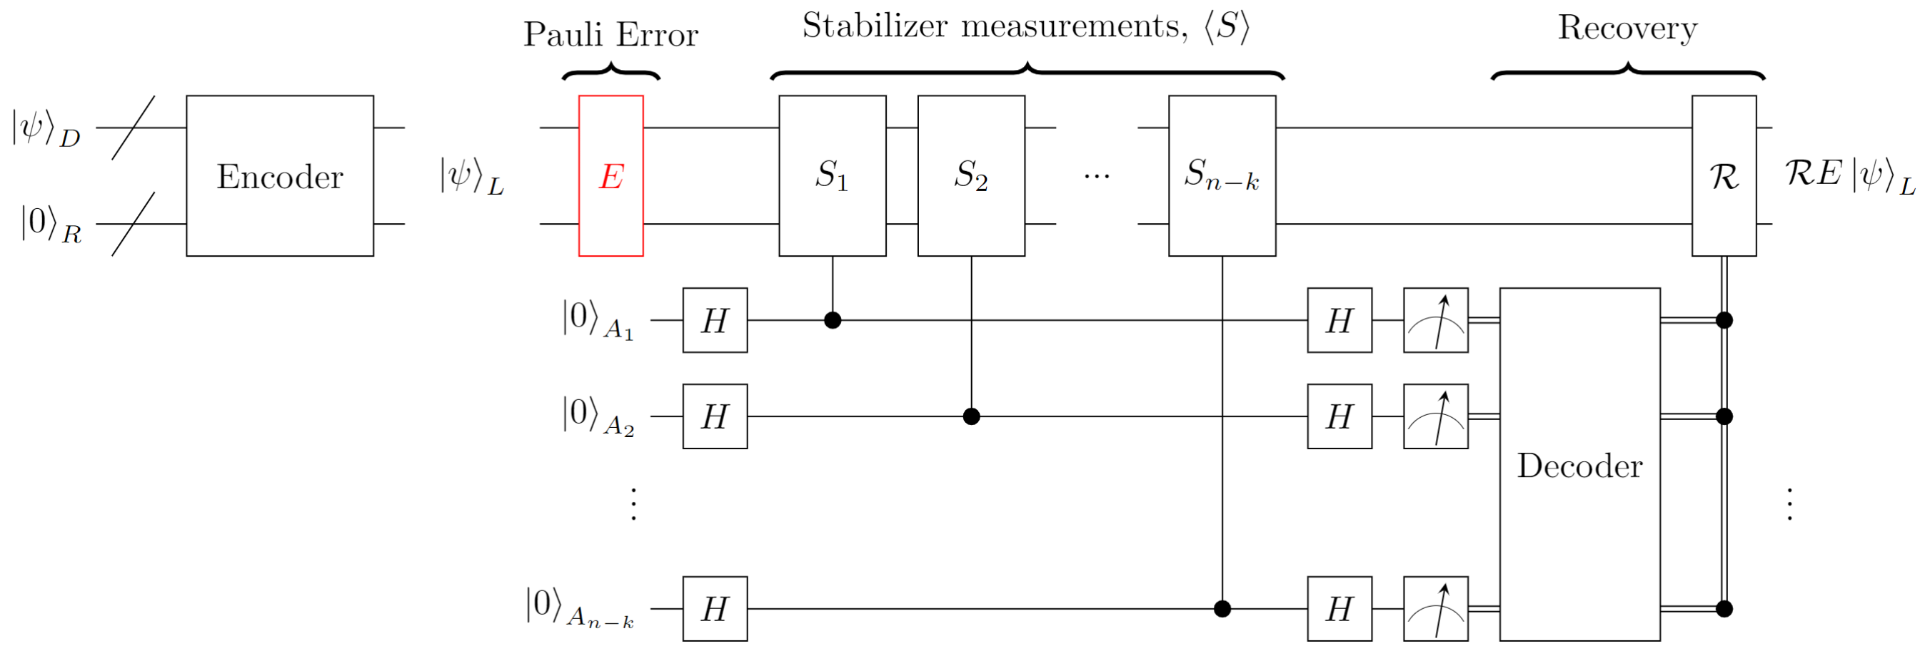
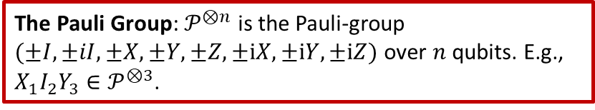
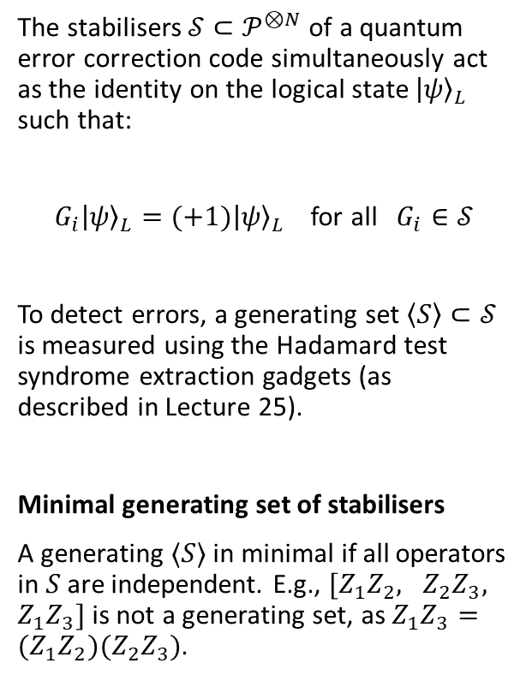
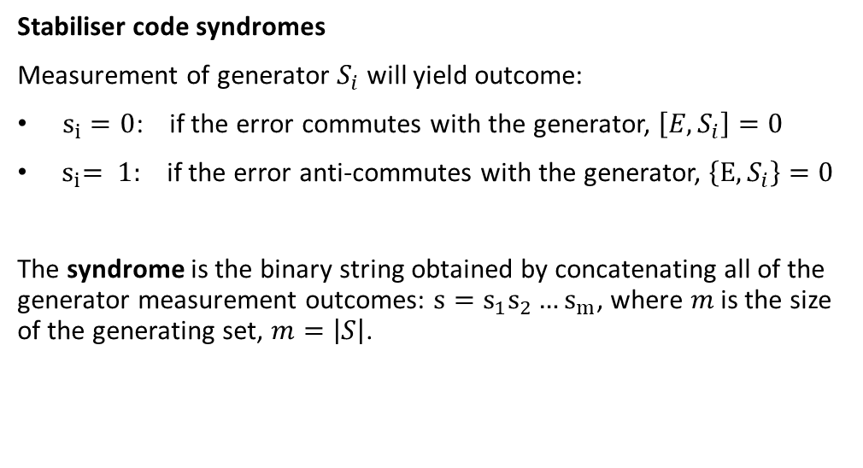
The Pauli Group: $𝒫^{⊗n}$ is the Pauli-group $(±I,±iI, ±X,±Y,±Z,±iX,±iY,±iZ)$ over $n$ qubits. E.g., $X_{1}I_{2}Y_{3}∈𝒫^{⊗3}$.
Recap: Stabiliser Codes
The stabilisers $𝒮⊂𝒫^{⊗N}$ of a quantum error correction code simultaneously act as the identity on the logical state ${\left|ψ\right\rangle }_{L}$ such that:
$G_{i}{\left|ψ\right\rangle }_{L}=(+1){\left|ψ\right\rangle }_{L}$ for all $G_{i}∈𝒮$
To detect errors, a generating set $\left\langle S\right\rangle ⊂𝒮$ is measured using the Hadamard test syndrome extraction gadgets (as described in Lecture 25).
Minimal generating set of stabilisers
A generating $⟨S⟩$ in minimal if all operators in $S$ are independent. E.g., $[Z_{1}Z_{2}, Z_{2}Z_{3}, Z_{1}Z_{3}]$ is not a generating set, as $Z_{1}Z_{3}={(Z}_{1}Z_{2})(Z_{2}Z_{3})$.
Stabiliser code syndromes
Measurement of generator $S_{i}$ will yield outcome:
$s_{i}=0$: if the error commutes with the generator, $\left[E,S_{i}\right]=0$
${ s}_{i}= 1:$ if the error anti-commutes with the generator, $\left\{E,S_{i}\right\}=0$
The syndrome is the binary string obtained by concatenating all of the generator measurement outcomes: $s=s_{1}s_{2}…s_{m}$, where $m$ is the size of the generating set, $m=\left|S\right|$.

Slide 3
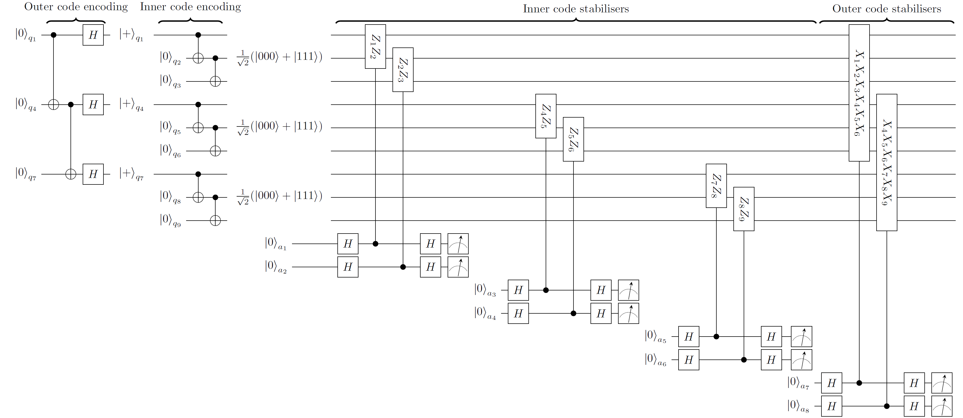
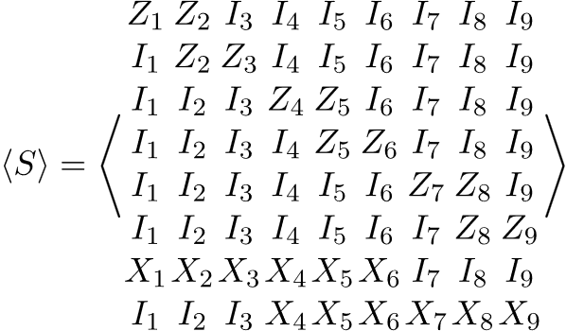
Recap: The [9,1,3] Shor Code

Slide 4
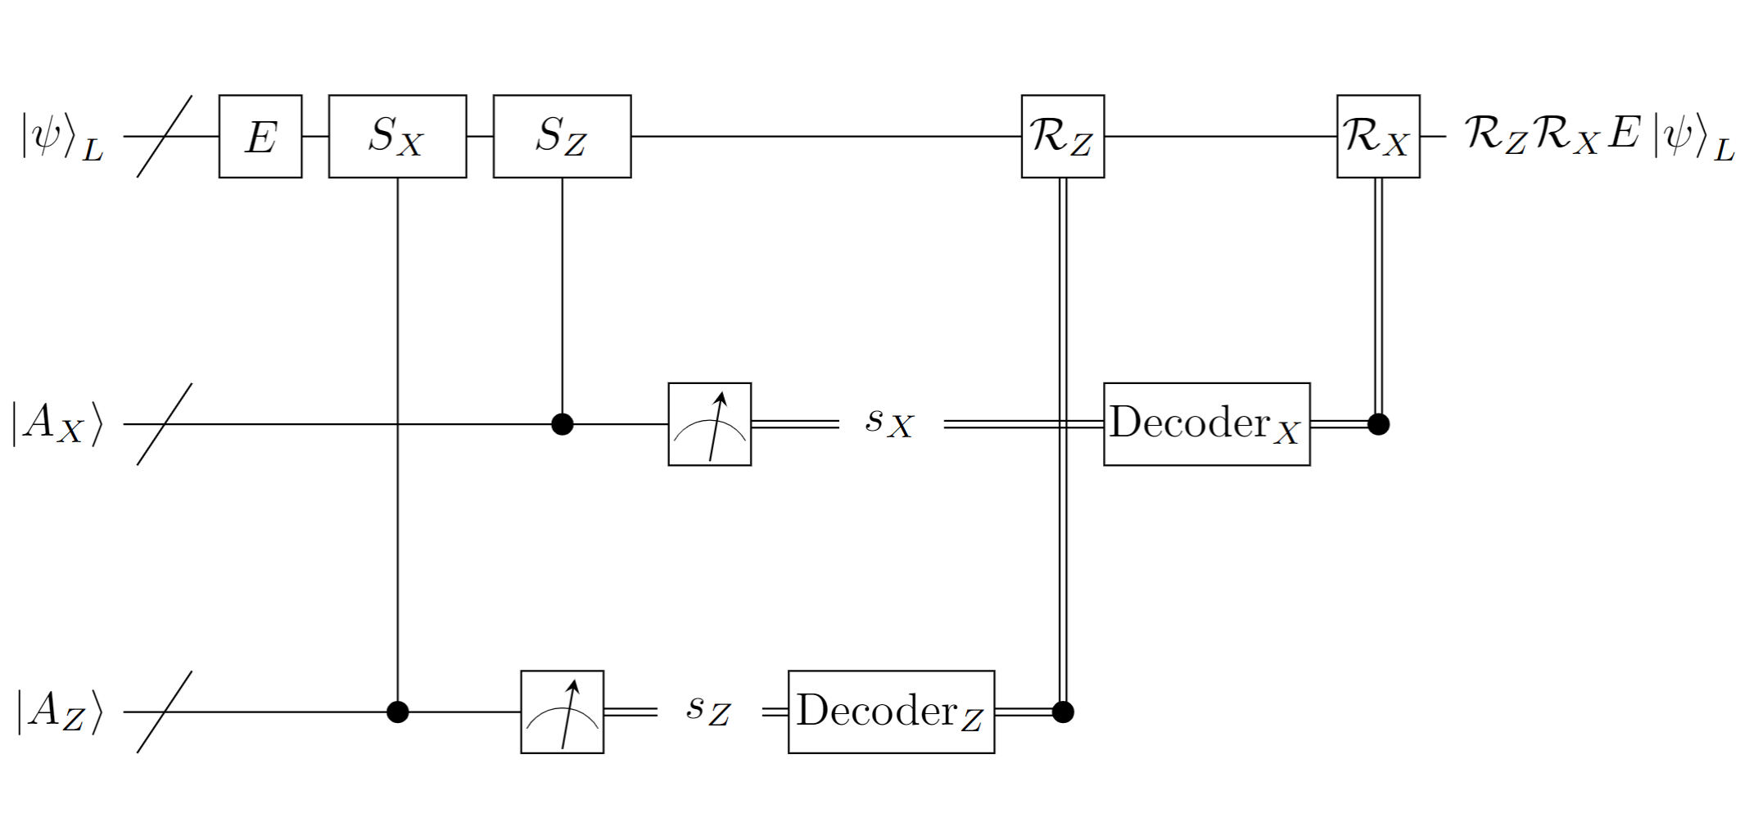
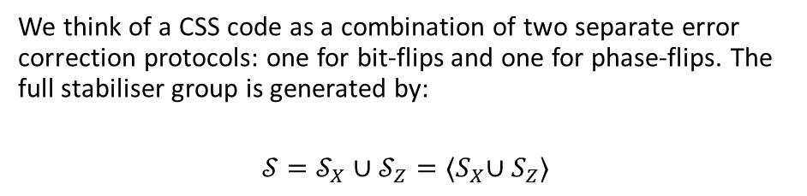

Calderbank-Shor-Steane (CSS) Codes
Note that the stabilisers for the nine qubit Shor code can be partitioned into two types:
X-type stabilisers $S_{X}$ that detect phase-flips
Z-type stabilisers $S_{Z}$ that detect bit-flips.
Quantum error correction codes that partition stabilisers in this way are referred to as Calderbank-Shor-Steane (CSS) codes. The [[4,2,2]] code, the [[7,1,3]] Steane code are also examples of CSS-type stabiliser codes.
We think of a CSS code as a combination of two separate error correction protocols: one for bit-flips and one for phase-flips. The full stabiliser group is generated by:
$$𝒮=𝒮_{X}∪𝒮_{Z}={⟨S}_{X}∪S_{Z}⟩$$

Slide 5
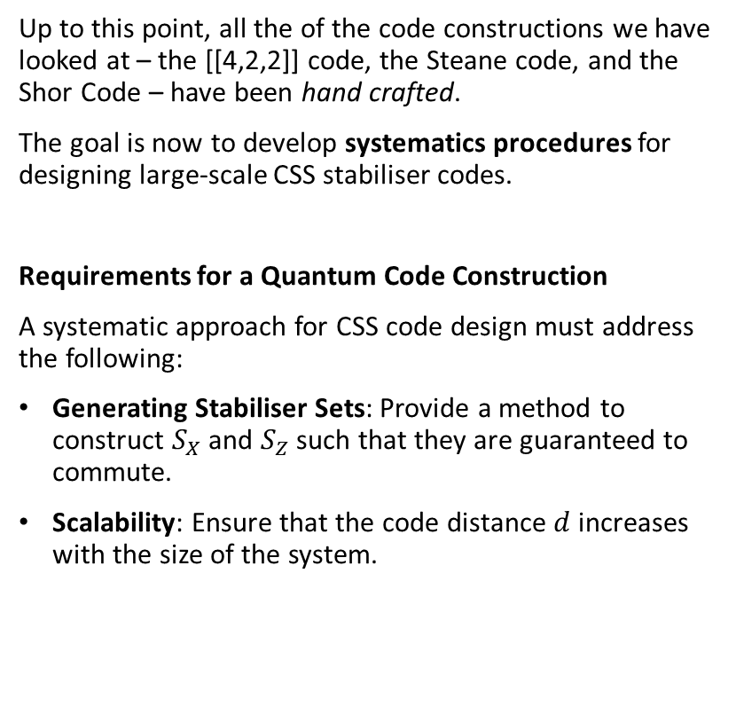
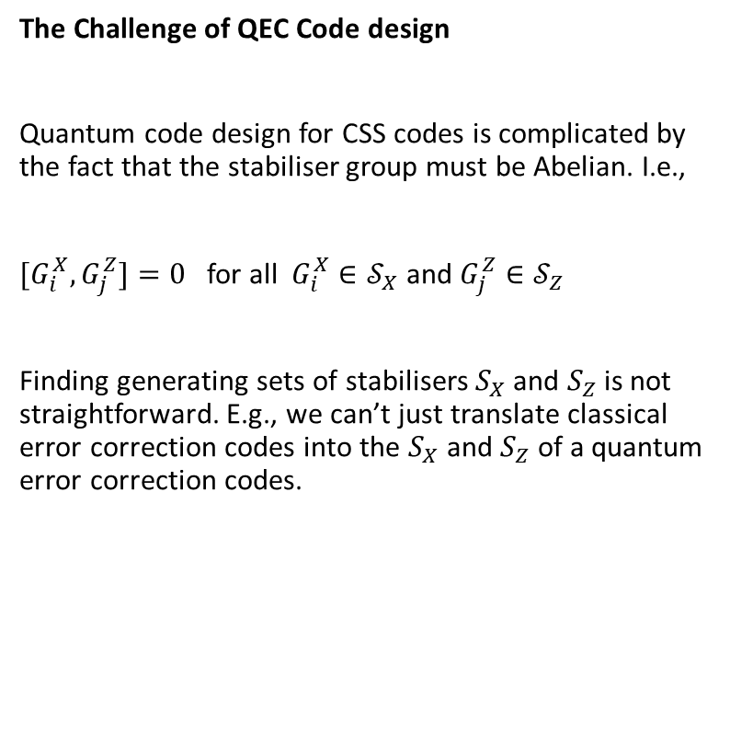
Quantum Error Correction Code Constructions
The Challenge of QEC Code design
Quantum code design for CSS codes is complicated by the fact that the stabiliser group must be Abelian. I.e.,
${[G}_{i}^{X},G_{j}^{Z}]=0$ for all $G_{i}^{X}∈𝒮_{X}$ and $G_{j}^{Z}∈𝒮_{Z}$
Finding generating sets of stabilisers $S_{X}$ and $S_{Z}$ is not straightforward. E.g., we can’t just translate classical error correction codes into the $S_{X}$ and $S_{Z}$ of a quantum error correction codes.
Up to this point, all the of the code constructions we have looked at – the [[4,2,2]] code, the Steane code, and the Shor Code – have been hand crafted.
The goal is now to develop systematics procedures for designing large-scale CSS stabiliser codes.
Requirements for a Quantum Code Construction
A systematic approach for CSS code design must address the following:
Generating Stabiliser Sets: Provide a method to construct $S_{X}$ and $S_{Z}$ such that they are guaranteed to commute.
Scalability: Ensure that the code distance $d$ increases with the size of the system.

Slide 6
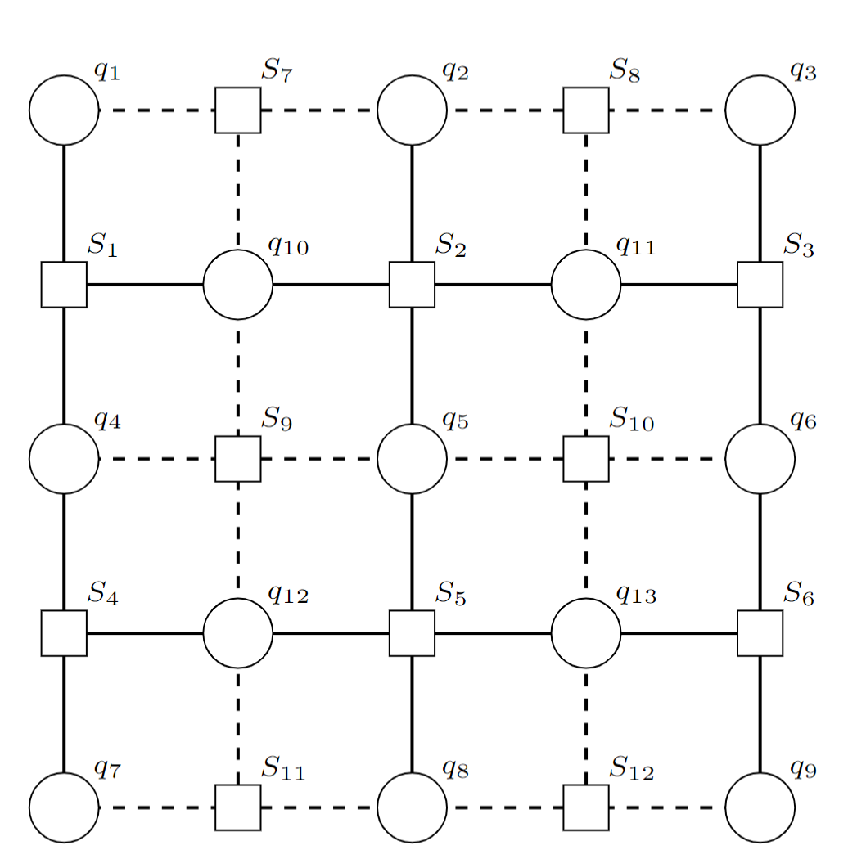
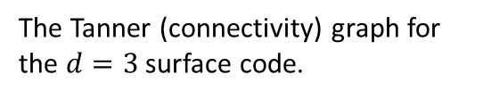
The Surface Code
The surface code is the leading construction for experimental quantum error correction. It has two major advantages:
It can be implemented using nearest-neighbour CNOT gates between qubits arrange in a two-dimensional grid. This is a particularly useful for many qubit hardware types – e.g. superconducting qubits – where long-range gates are difficult to implement with high-fidelity.
The distance can be straightforwardly scaled by increasing the size of the qubit grid.
The Tanner (connectivity) graph for the $d=3$ surface code.

Slide 7
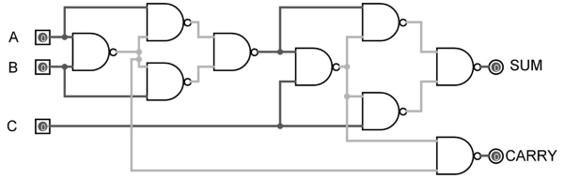
Classical vs. Quantum Circuits
Classical circuit
Provides information about what operations are performed.
Tells us exactly how to wire together the circuit.
Quantum Circuit
Provides information about what operations are performed.
Wires represent the passage of time. I.e., they do not actually correspond to wires and tell us nothing about the qubit connectivity.

Slide 8
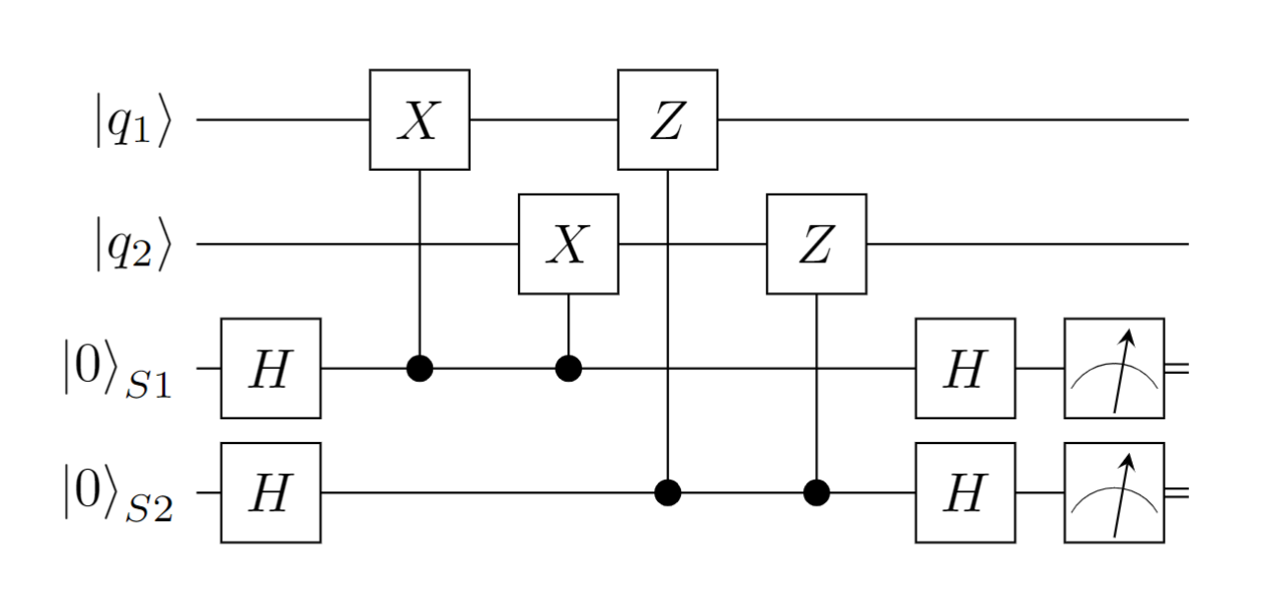
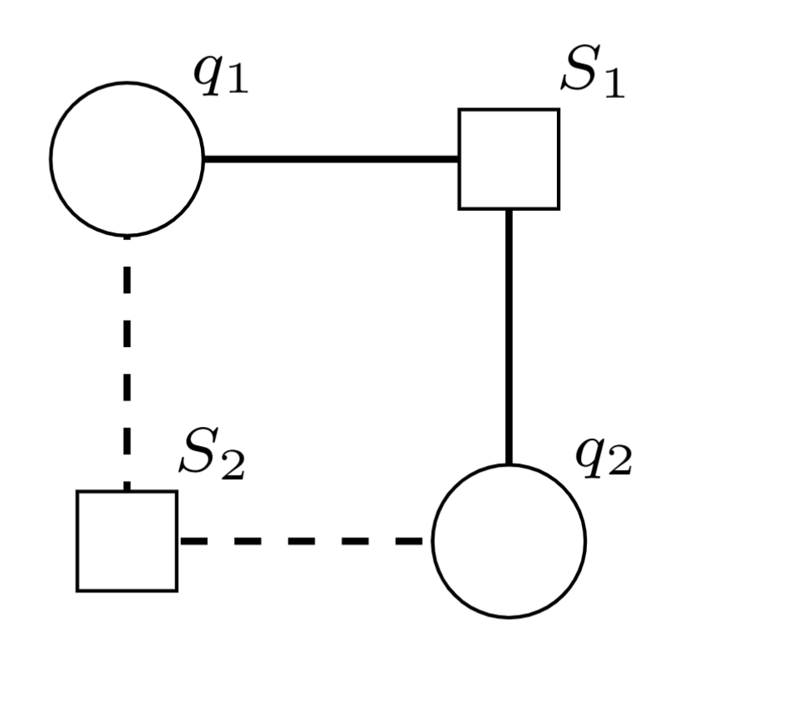
The Tanner Graph Representation of QEC
Tanner graphs provide a graphical representation of quantum error correction that allows us to design codes in a way that is connectivity aware.

Slide 9
The Tanner Graph Representation of QEC
Tanner graphs provide a graphical representation of quantum error correction that allows us to design codes in a way that is connectivity aware.
Data qubits

Slide 10
The Tanner Graph Representation of QEC
Tanner graphs provide a graphical representation of quantum error correction that allows us to design codes in a way that is connectivity aware.
X-type stabiliser measurement qubit
Z-type stabiliser measurement qubit

Slide 11
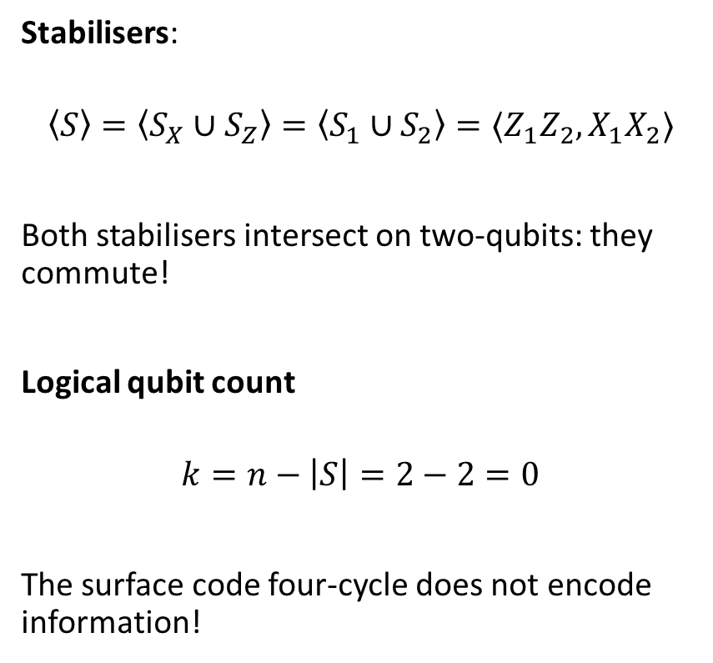
The Surface Code 4-Cycle
Stabilisers:
$$\left\langle S\right\rangle =\left\langle S_{X}∪S_{Z}\right\rangle =\left\langle S_{1}∪S_{2}\right\rangle =⟨Z_{1}Z_{2}, X_{1}X_{2}⟩$$
Both stabilisers intersect on two-qubits: they commute!
Logical qubit count
$$k=n−\left|S\right|=2−2=0$$
The surface code four-cycle does not encode information!
X-type stabiliser measurement qubit
Data qubit 1
Data qubit 2
Z-type stabiliser measurement qubit

Slide 12
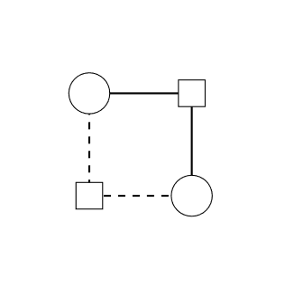
The Surface Code
Larger surface codes can be constructed by tiling four-cycles together.

Slide 13
The Surface Code
Larger surface codes can be constructed by tiling four-cycles together.

Slide 14

The $d=3$ Surface Code
Larger surface codes can be constructed by tiling four-cycles together.
The construction guarantees that any two X- and Z-type stabiliser always intersect non-trivially on an even number of qubits. => The stabilisers always commute!

Slide 15
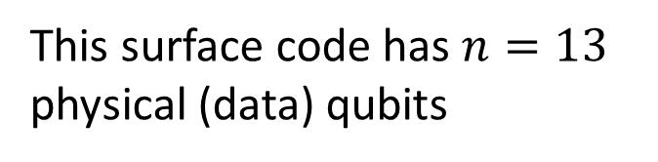
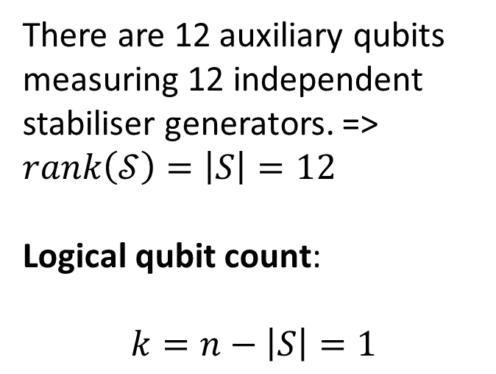
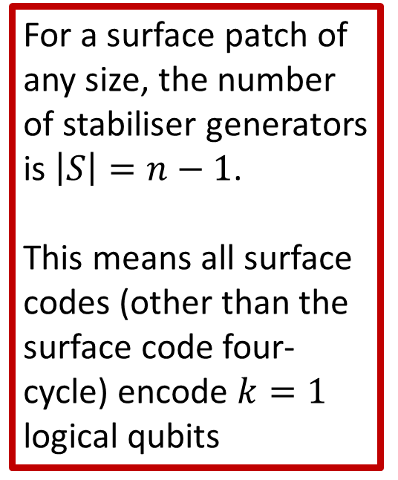
Surface codes: logical qubit count
This surface code has $n=13$ physical (data) qubits
For a surface patch of any size, the number of stabiliser generators is $\left|S\right|=n−1$.
This means all surface codes (other than the surface code four-cycle) encode $k=1$ logical qubits
There are 12 auxiliary qubits measuring 12 independent stabiliser generators. => $rank\left(𝒮\right)=\left|S\right|=12$
Logical qubit count: $$k=n−\left|S\right|=1$$

Slide 16
Surface codes: error detection
Surface codes are CSS codes: X- and Z-type errors are detected by different stabilisers.

Slide 17
Surface codes: error detection
X-error
Surface codes are CSS codes: X- and Z-type errors are detected by different stabilisers.
1
Z-type stabiliser measurement syndrome
X
1

Slide 18
Surface codes: error detection
Z-error
Surface codes are CSS codes: X- and Z-type errors are detected by different stabilisers.
1
Z
1
X-type stabiliser measurement
syndrome

Slide 19
Surface codes: error detection
X-error
Z-error
Surface codes are CSS codes: X- and Z-type errors are detected by different stabilisers.
1
Z-type stabiliser measurement syndrome
X
1
1
Z
1
X-type stabiliser measurement
syndrome

Slide 20
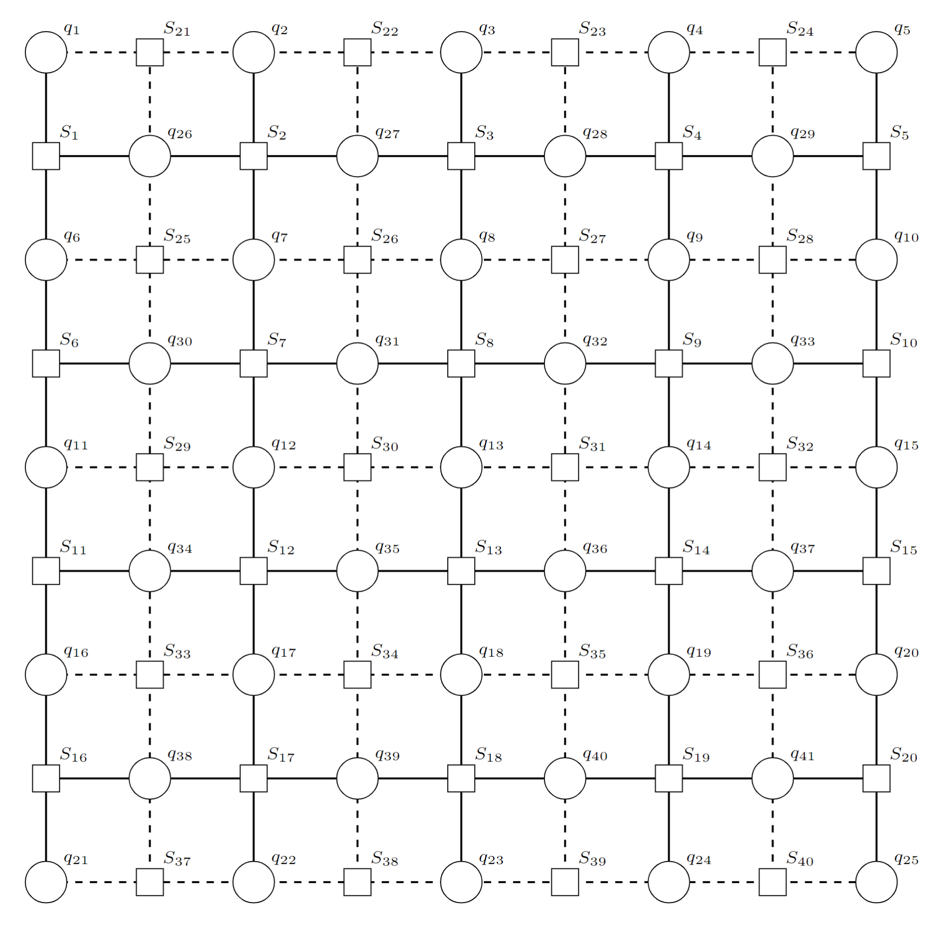
Surface code: error chains
1

Slide 21
Surface code: error chains
Error chains in the bulk have syndrome Hamming weight 2.
X-error
chain
1
X
X
X
X
1

Slide 22
Surface code: error chains
Error chains in the bulk have syndrome Hamming weight 2.
X-error
chain
1
X
X
X
X
1
1
Z
Z-error
chain
Z
Z
1

Slide 23
Surface code: error chains
Error chains in the bulk have syndrome Hamming weight 2.
Error chains starting at the boundary have syndrome Hamming weight 1.
X-error
chain
1
X
X
X
X
1
X
1
X-type
boundary error
1
Z
Z-error
chain
Z
Z
1

Slide 24
Surface code: error chains
Z-type
boundary error
Z
Error chains in the bulk have syndrome Hamming weight 2.
Error chains starting at the boundary have syndrome Hamming weight 1.
X-error
chain
1
X
X
Z
X
1
X
1
X
1
X-type
boundary error
1
Z
Z-error
chain
Z
Z
1

Slide 25
Zero-syndrome error chains
If two boundary error chains merge, we get an undetectable zero-weight syndrome.
X
1
X
1

Slide 26
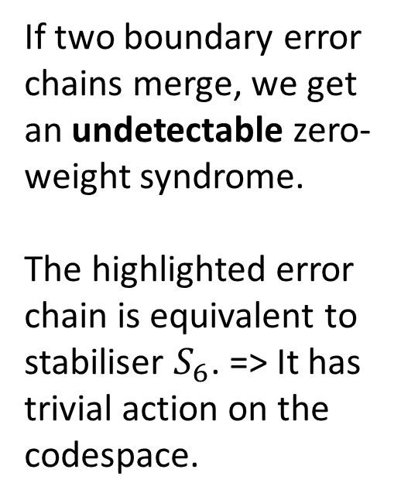
Zero-syndrome error chains
If two boundary error chains merge, we get an undetectable zero-weight syndrome.
The highlighted error chain is equivalent to stabiliser $S_{6}$. => It has trivial action on the codespace.
X
X
X

Slide 27
Logical operators
If two boundary error chains merge, we get an undetectable zero-weight syndrome.
If boundary operators from opposite ends of the lattice merge, we get a non-zero syndrome error chain that is not in the stabiliser group. This is a logical operator.
X
X
1
1
X
X
X

Slide 28
Logical operators
If two boundary error chains merge, we get an undetectable zero-weight syndrome.
If boundary operators from opposite ends of the lattice merge, we get a non-zero syndrome error chain that is not in the stabiliser group. This is a logical operator.
X
X
X
X
X
X

Slide 29
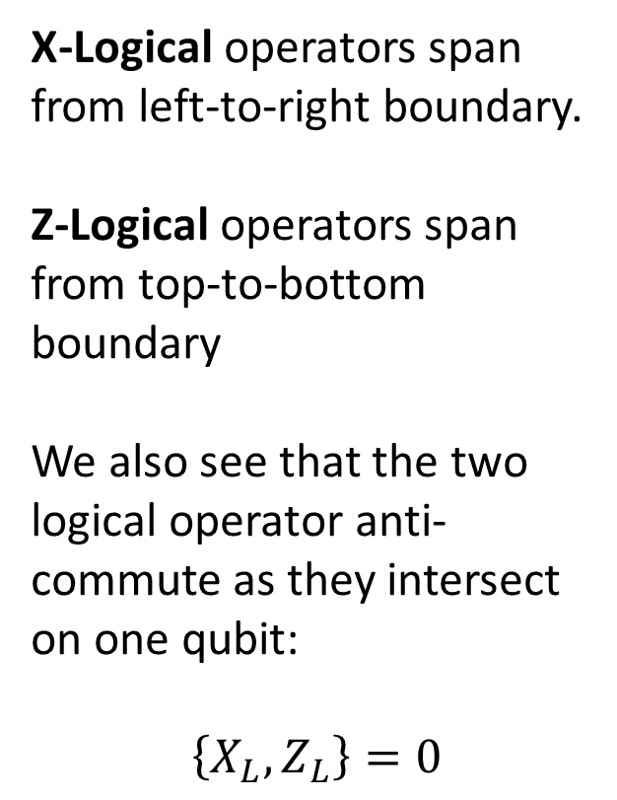
X- and Z-logical operators
Z
X-Logical operators span from left-to-right boundary.
Z-Logical operators span from top-to-bottom boundary
We also see that the two logical operator anti-commute as they intersect on one qubit: $$\left\{X_{L},Z_{L}\right\}=0$$
X
Z
X
X
X
Z
X
X
Z
Z
Z

Slide 30
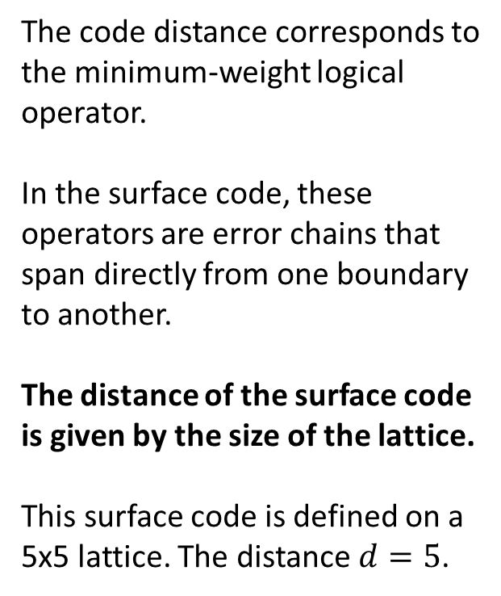
Surface code distance
Z
The code distance corresponds to the minimum-weight logical operator.
In the surface code, these operators are error chains that span directly from one boundary to another.
The distance of the surface code is given by the size of the lattice.
This surface code is defined on a 5x5 lattice. The distance $d=5$.
Z
X
X
X
Z
X
X
Z
Z

Slide 31
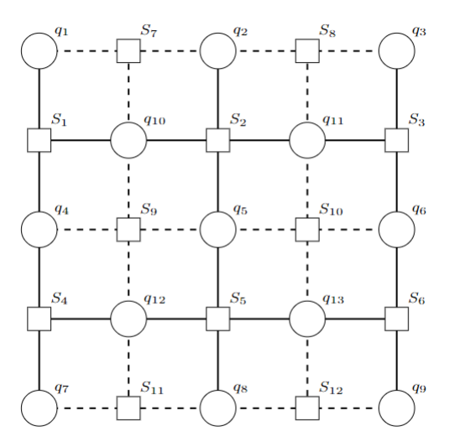
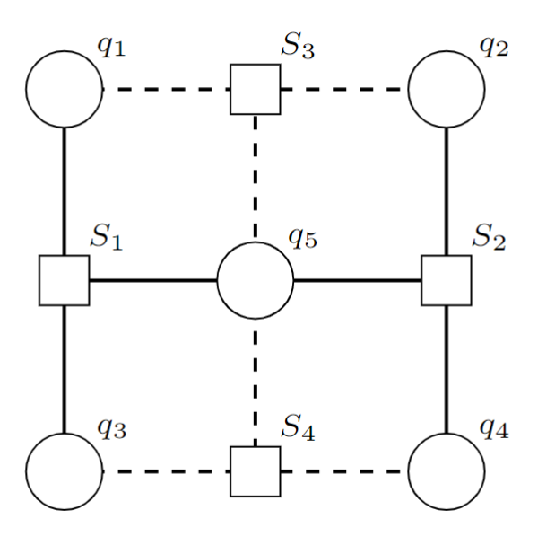
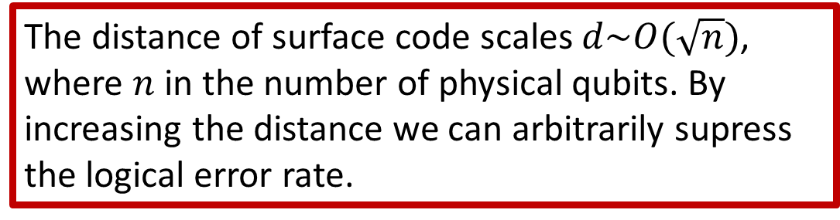
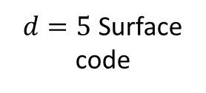
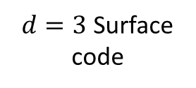
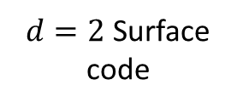
Scaling the Surface Code
$d=2$ Surface code
$d=3$ Surface code
The distance of surface code scales $d\sim O(\sqrt{n})$, where $n$ in the number of physical qubits. By increasing the distance we can arbitrarily supress the logical error rate.
$d=5$ Surface code

Slide 32
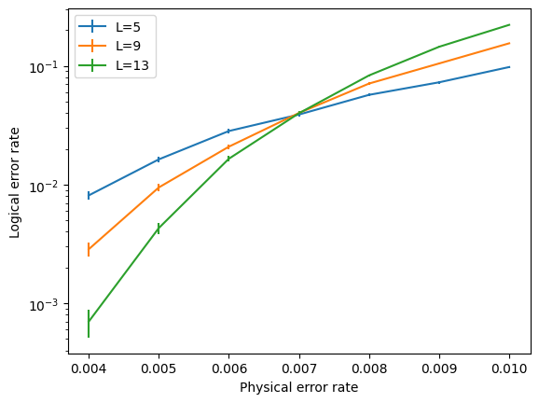
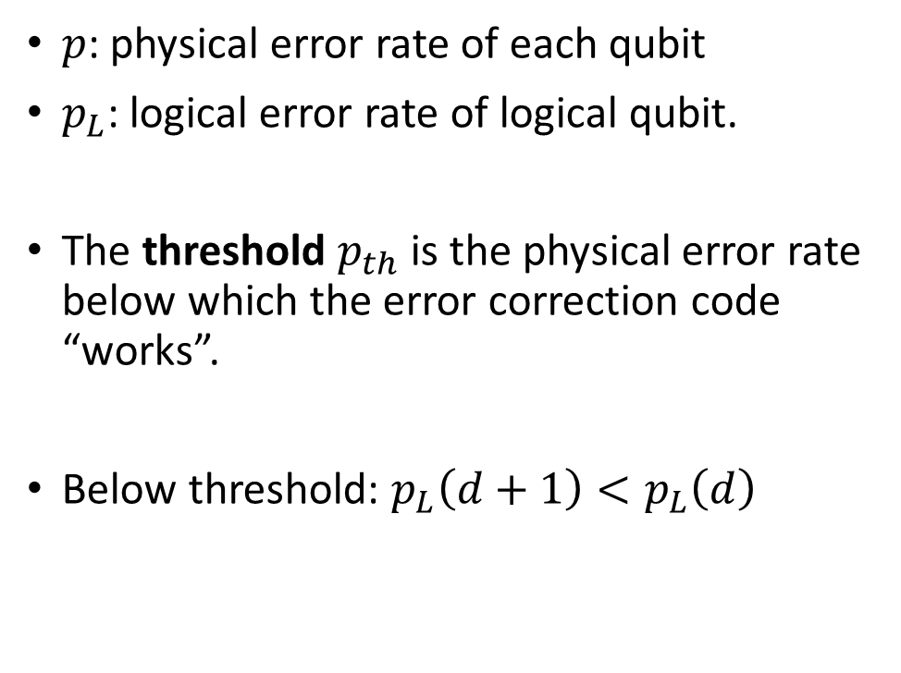

Surface Code Threshold
Threshold, $p_{th}$
$p$: physical error rate of each qubit
$p_{L}$: logical error rate of logical qubit.
The threshold $p_{th}$ is the physical error rate below which the error correction code “works”.
Below threshold: $p_{L}\left(d+1\right)<p_{L}\left(d\right)$
A surface code threshold plot simulated using the PyMatching package.

Slide 33
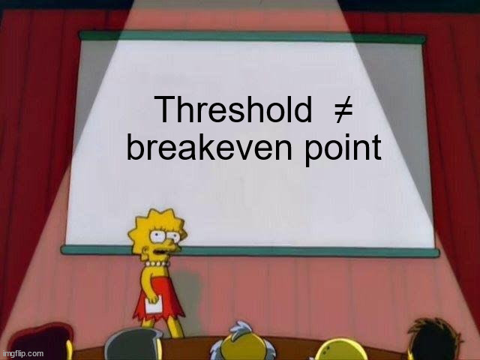
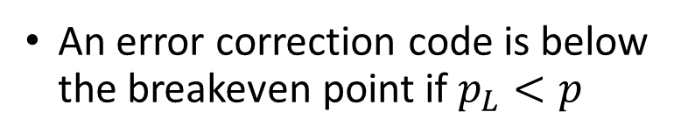

The Threshold and the Breakeven Point
Threshold, $p_{th}$
Breakeven
Line
An error correction code is below the breakeven point if $p_{L}<p$

Slide 34
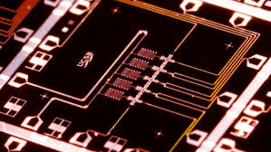
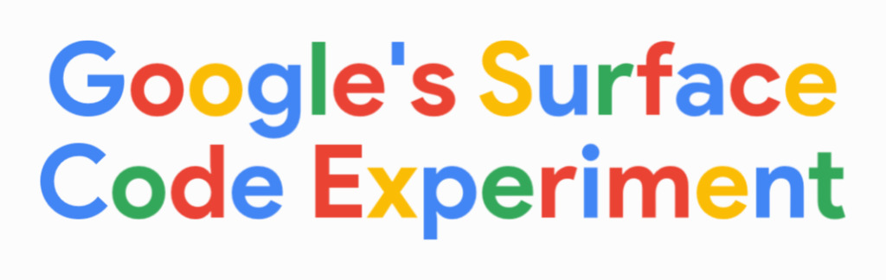
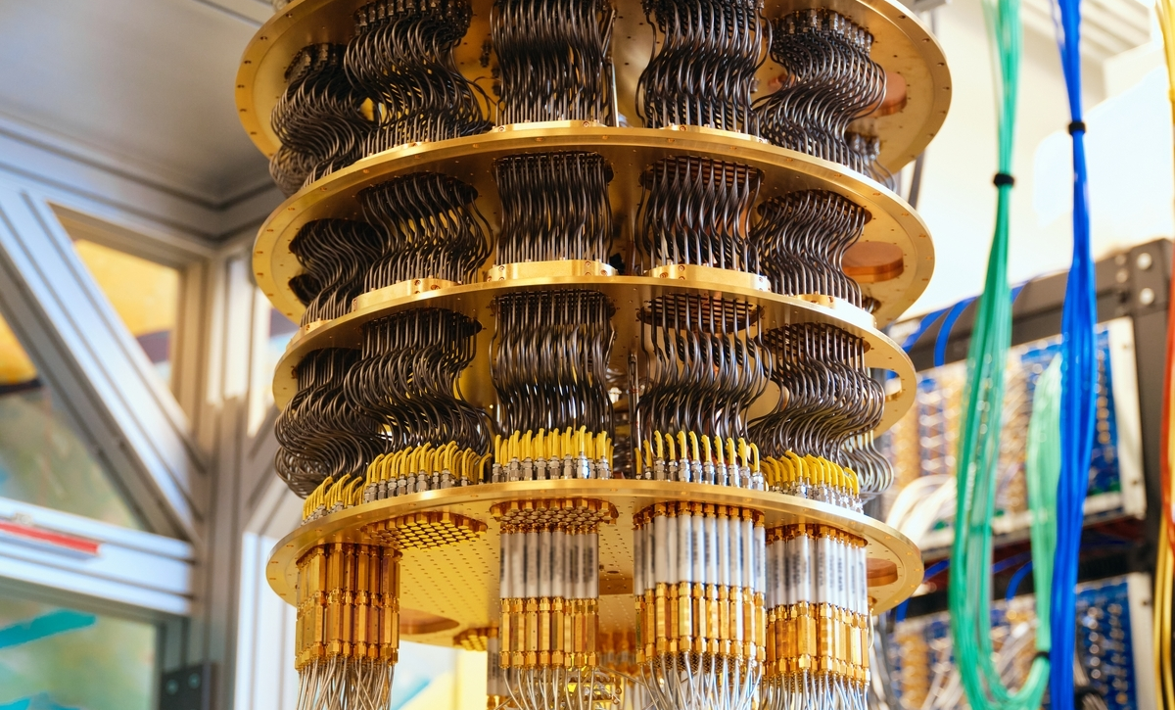
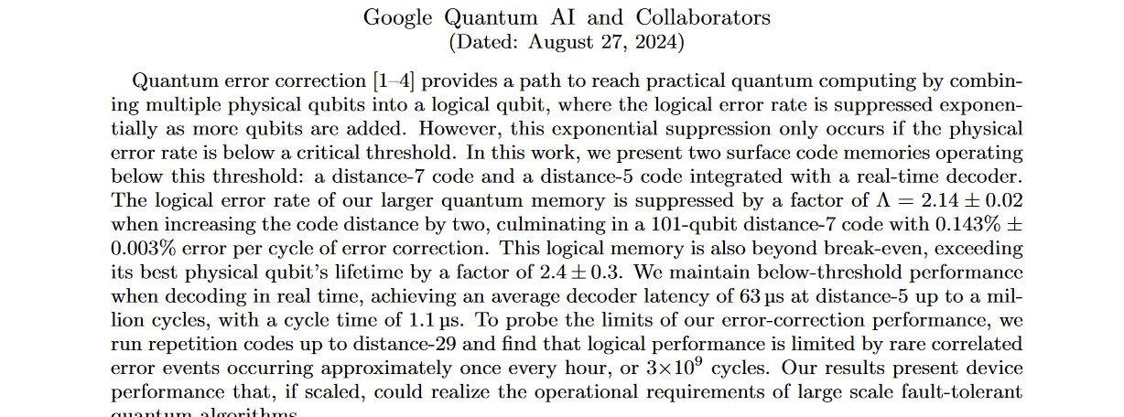

Slide 35

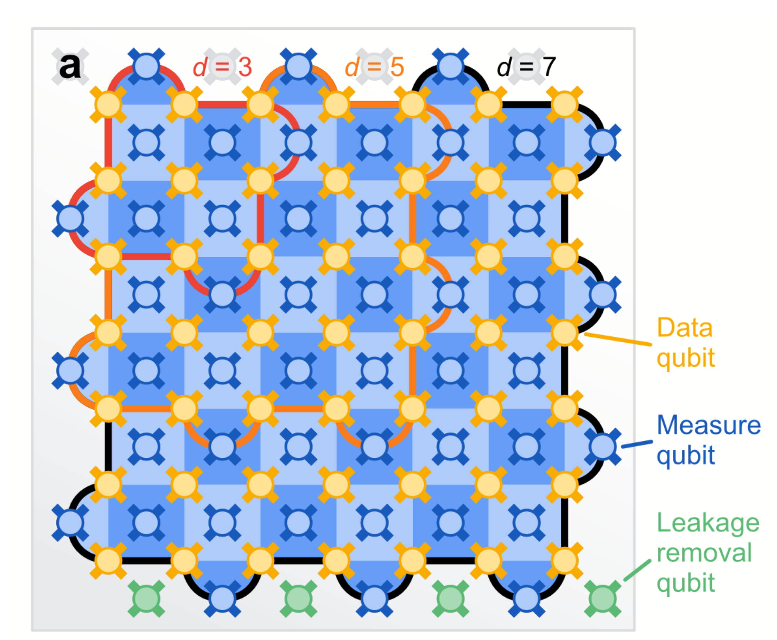
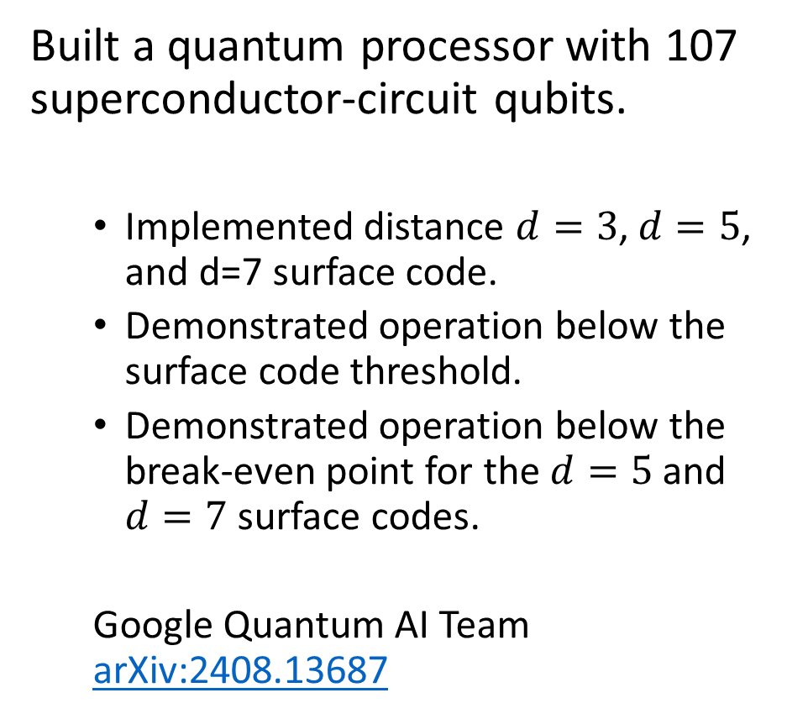
What have Google Achieved?
The first demonstration of a fault-tolerant logical qubit operating below the break-even point. Quantum error correction works!
Built a quantum processor with 107 superconductor-circuit qubits.
Implemented distance $d=3$, $d=5$, and d=7 surface code.
Demonstrated operation below the surface code threshold.
Demonstrated operation below the break-even point for the $d=5$ and $d=7$ surface codes.
Google Quantum AI Team arXiv:2408.13687

Slide 36
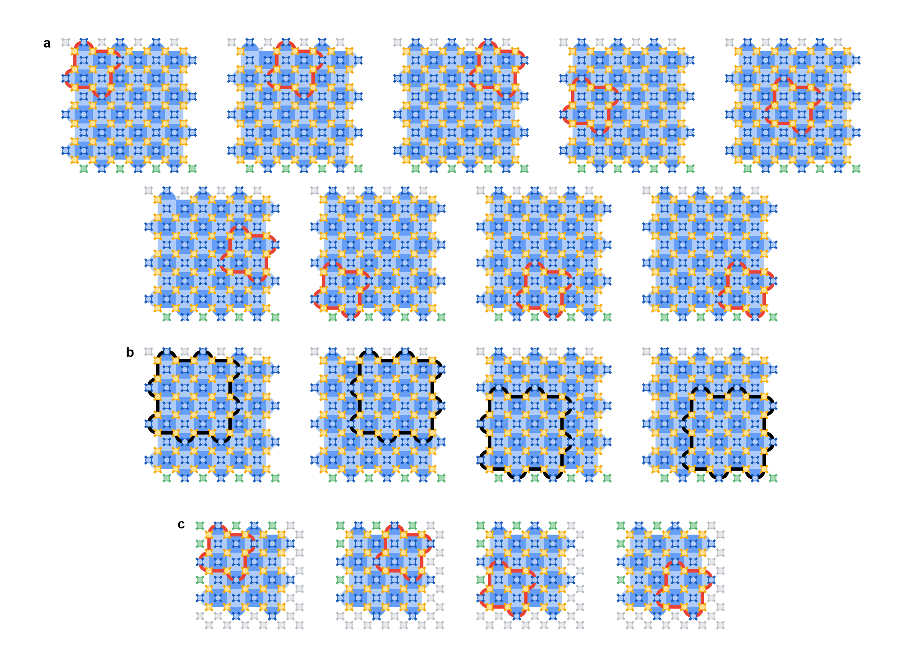

Slide 37
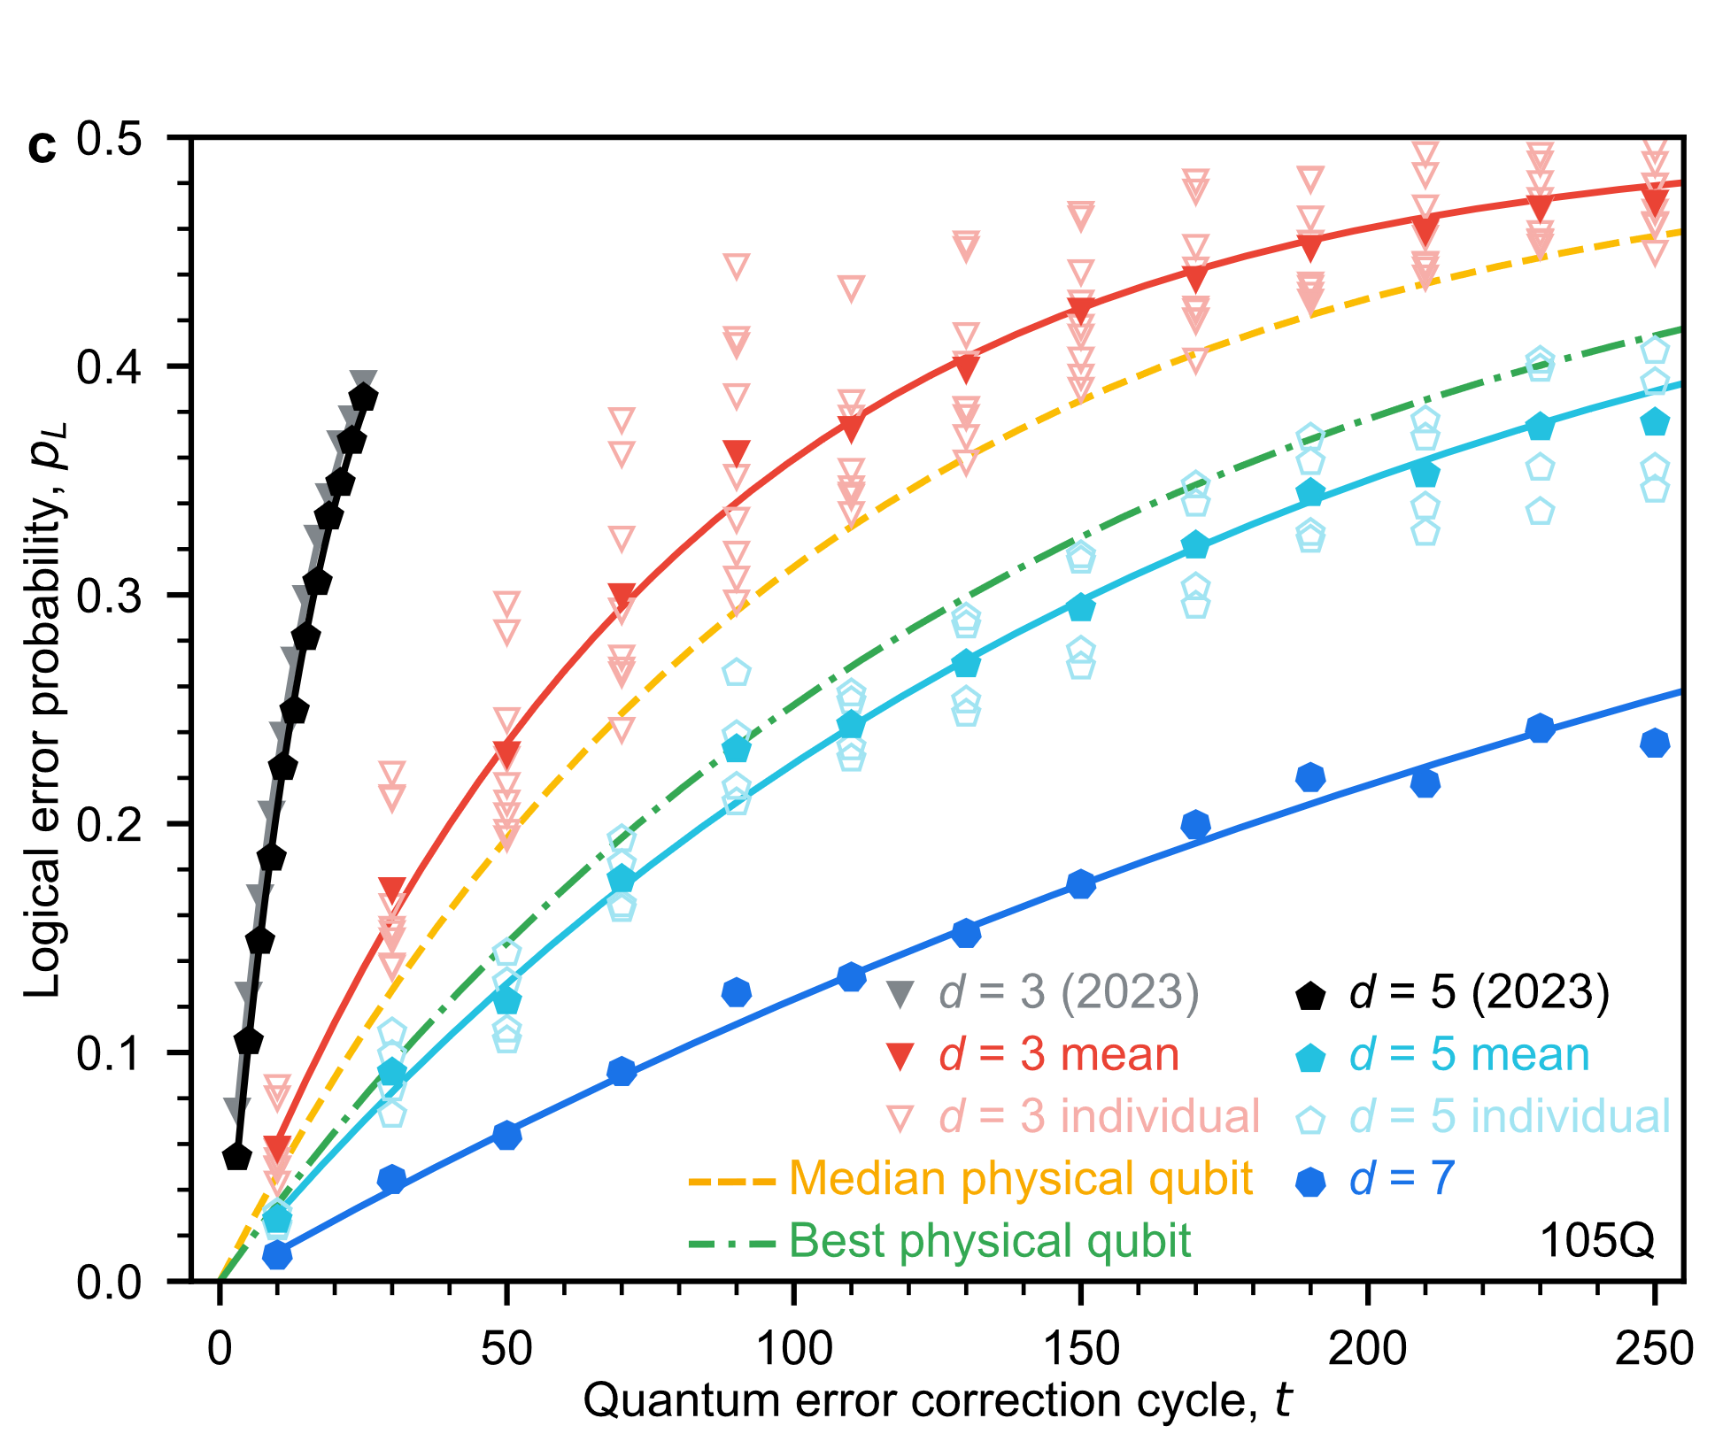
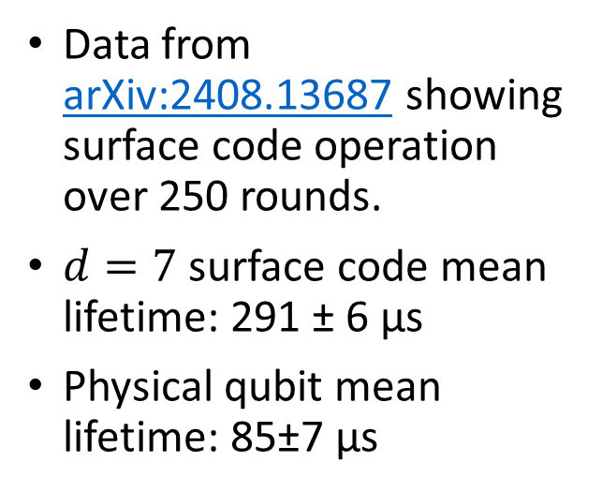
Google’s Experimental Results
Data from arXiv:2408.13687 showing surface code operation over 250 rounds.
$d=7$ surface code mean lifetime: 291 ± 6 μs
Physical qubit mean lifetime: 85±7 μs

Slide 38
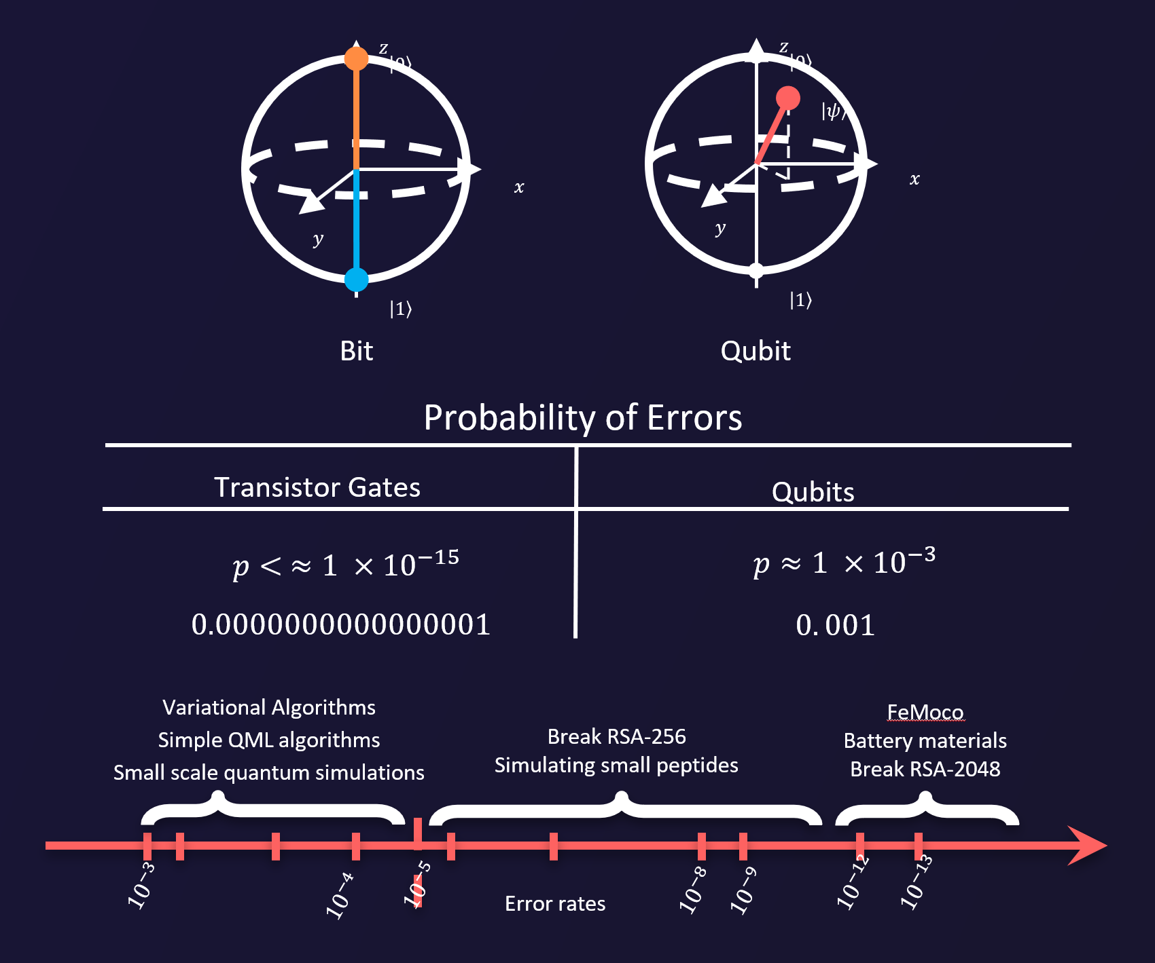
Reaching algorithm ally useful error regimes
Extremely low logical error rates will be required for operationally useful quantum computing.
Figure credit: Tamas Noszko, Liam Veeder-Sweeney, Boren Gu, Adi Sireesh.

Slide 39
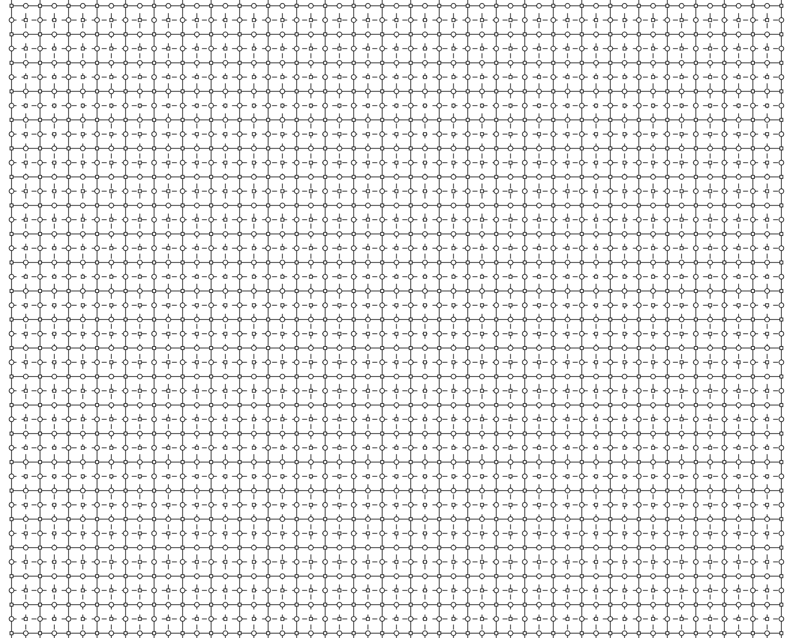
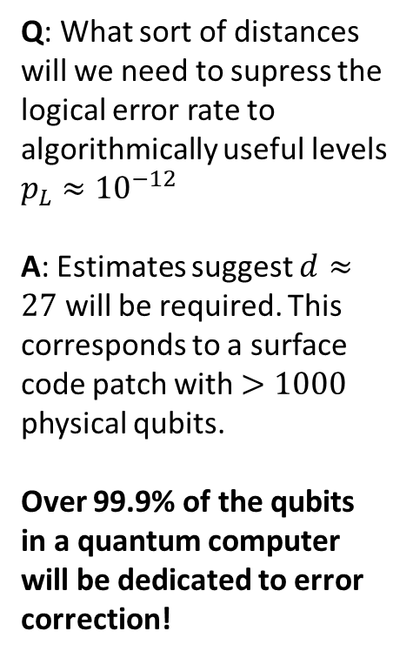
Q: What sort of distances will we need to supress the logical error rate to algorithmically useful levels $p_{L}≈{10}^{−12}$ A: Estimates suggest $d≈27$ will be required. This corresponds to a surface code patch with $>1000$ physical qubits.
Over 99.9% of the qubits in a quantum computer will be dedicated to error correction!

Slide 40
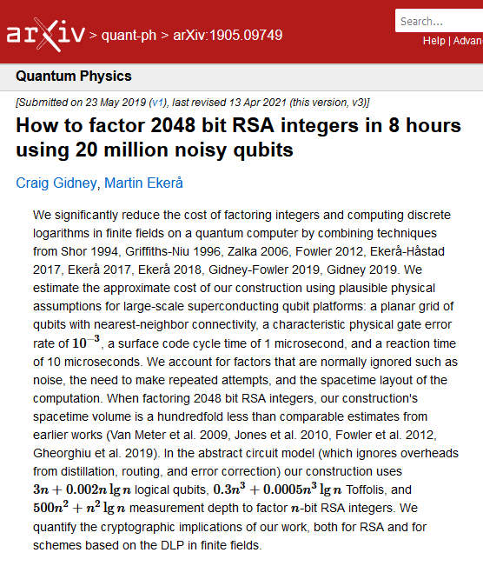
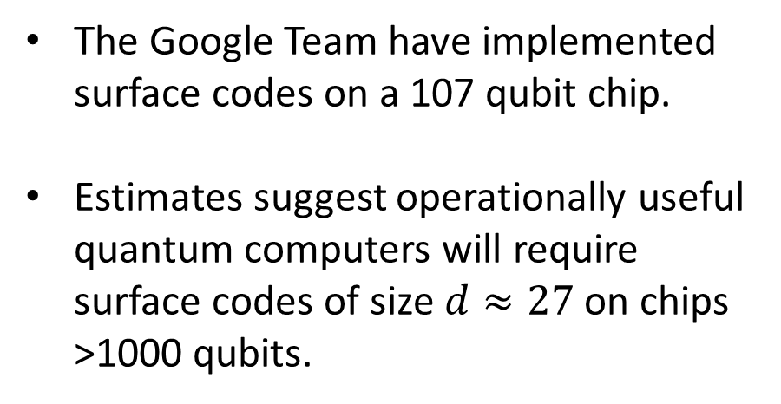
When will surface code quantum computers be useful?
The Google Team have implemented surface codes on a 107 qubit chip.
Estimates suggest operationally useful quantum computers will require surface codes of size $d≈27$ on chips >1000 qubits.

Slide 41
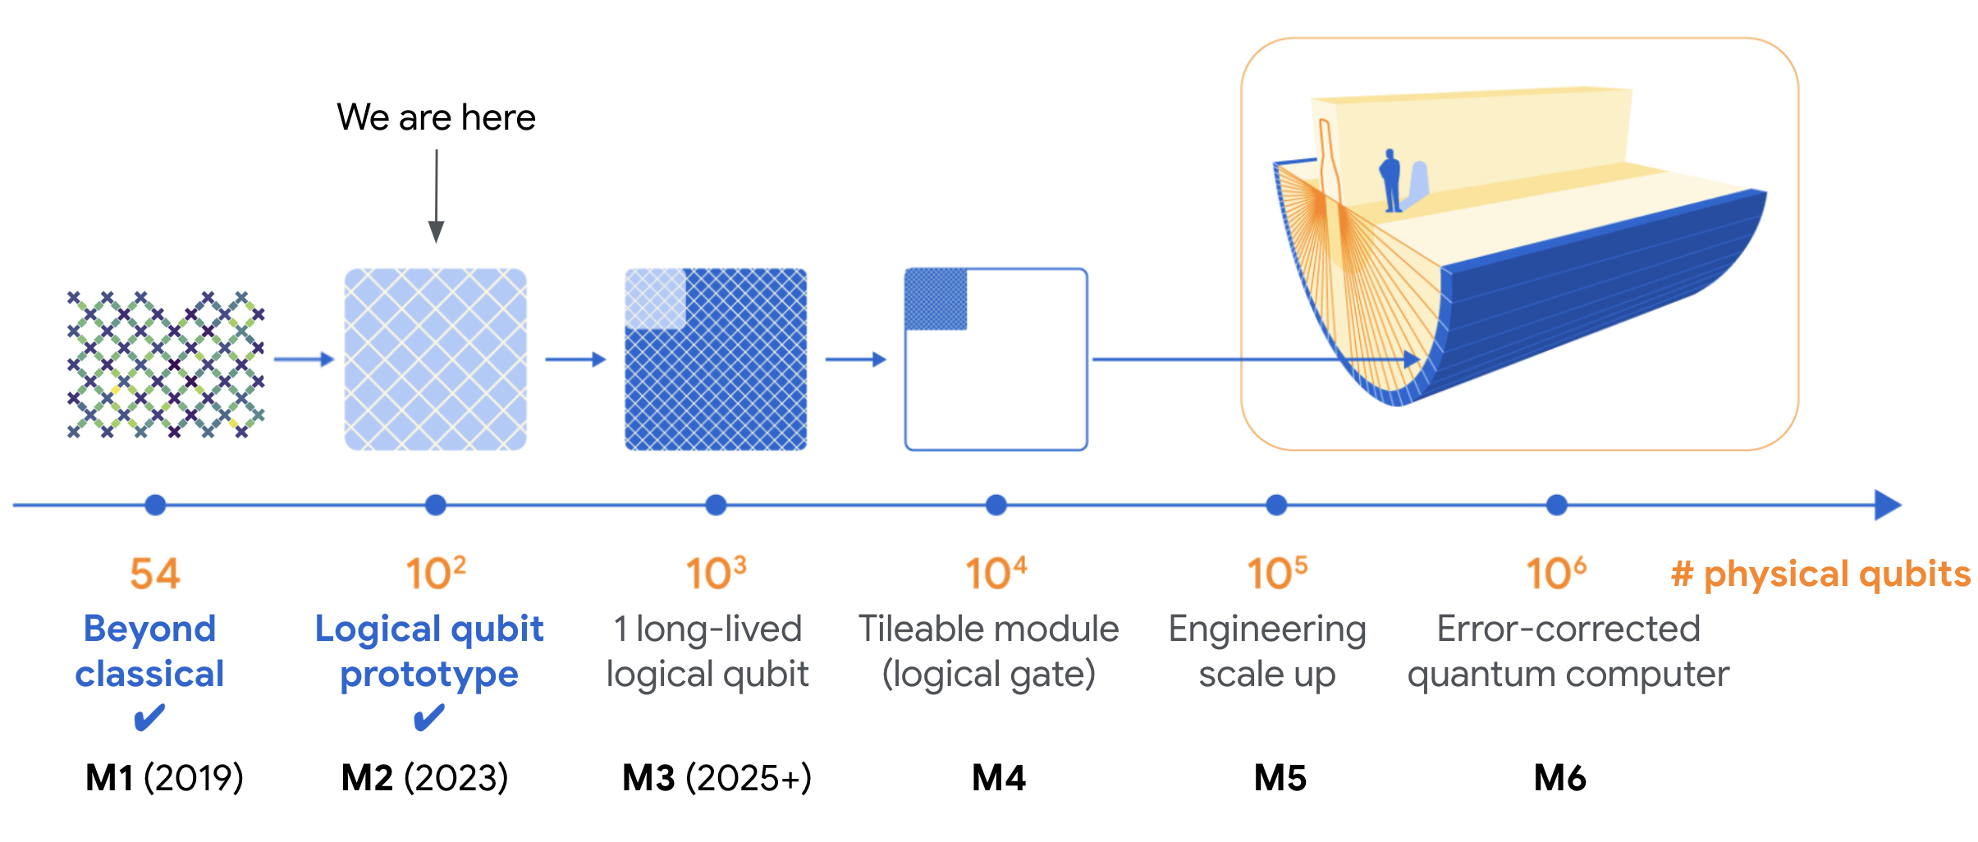
Google’s Roadmap to Fault-Tolerance

Slide 42


Want to join the quantum revolution?
Apply for our new Centre for Doctoral Training in Quantum Informatics
We are recruiting 16 PhD students to start September 2026.
Positions are fully funded for 4 years.
Project opportunities in a wide range of topics in quantum computing (including quantum error correction).
Contact me (joschka.roffe@ed.ac.uk), Chris, Raul or Petros if you have any questions.

