Slide 1
IQC QEC | Revision Lecture
Instructor: Joschka Roffe, joschka.roffe@ed.ac.uk

Slide 2
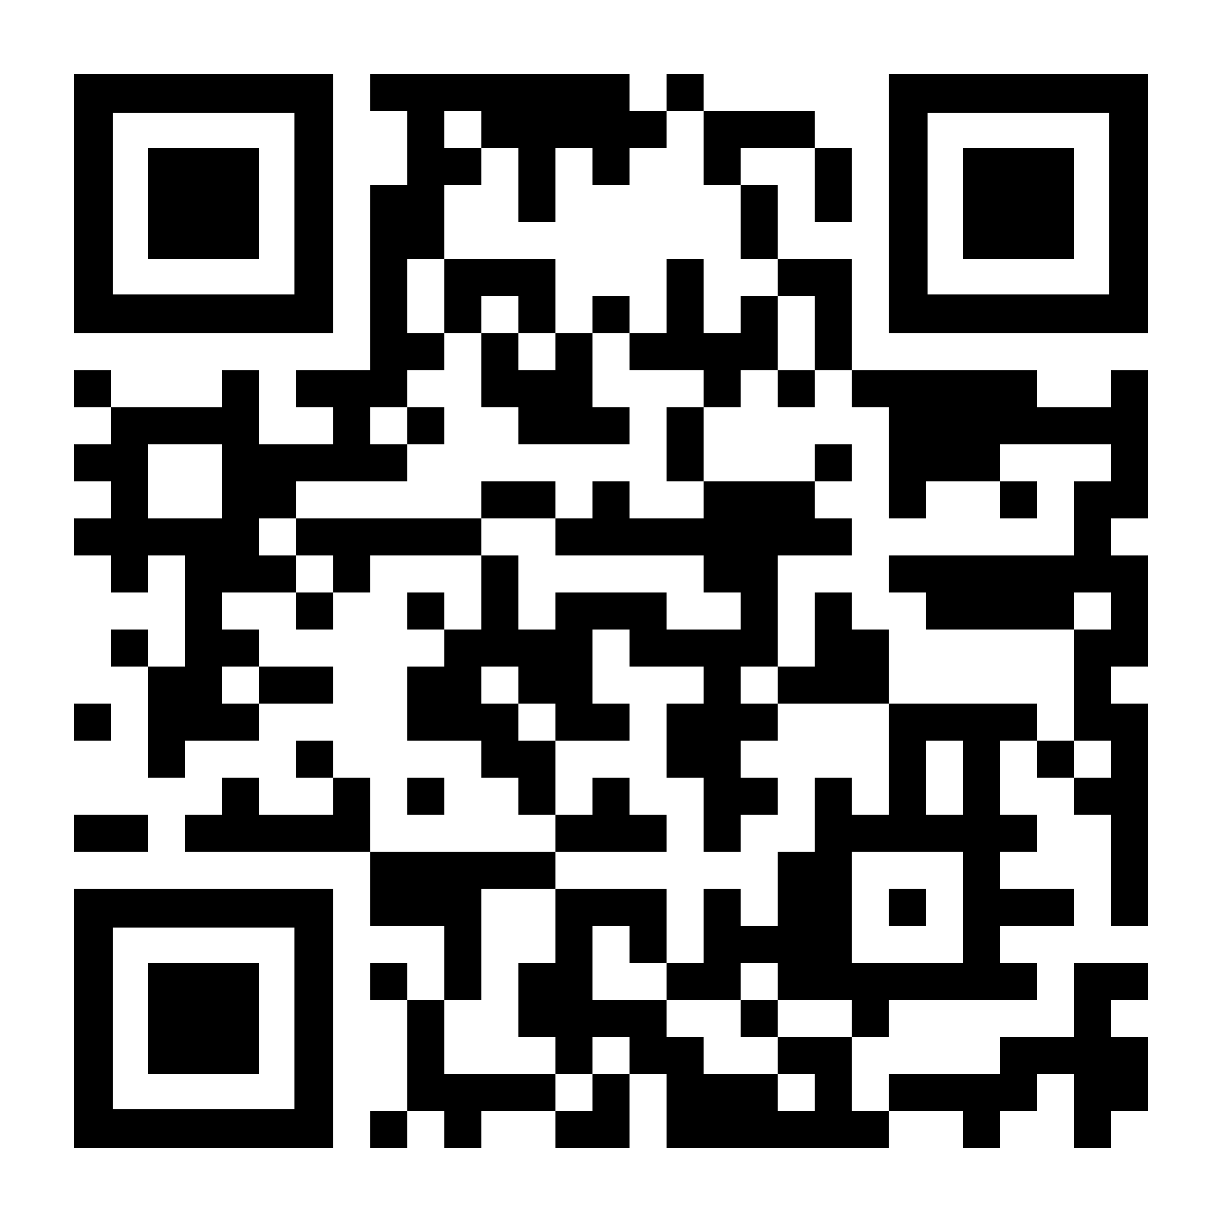
Download Slides: https://roffe.eu/lectures/iqc25
Everything in the lecture notes and tutorial questions is examinable material (unless stated otherwise).
All materials are available via the website 👉
Any questions? Send me an email: joschka.roffe@ed.ac.uk

Slide 3
IQC Revision
Lecture 27 – QEC Basics

Slide 4
Lecture 27 | QEC Basics | Need-to-Know
Challenges of QEC: No-Cloning theorem; Multiple error types (X/Z errors); Wavefunction collapse.
Logical states: Understand subspace encoding and how this allows redundancy to be added to the system without cloning.
Error detection via (Hadamard test) stabiliser measurement. Understand why the measurement of the auxiliary qubit in the stabiliser extraction circuit is deterministic and how this resolves the problem of wavefunction collapse. Tutorial 9, Q2
The digitisation of the error. Understand why it is sufficient to design quantum error correction codes that correct bit- (X) and phase (Z)-flip errors.
Pauli commutation rules. You should be able to determine whether two Pauli operators commute or anti-commute by counting the number of non-trivial intersections. Tutorial 9, Q1.
Understand how the syndrome measurement depends on whether the error commutes or anti-commutes with the stabiliser being measured. Tutorial 9, Q2
You should be able to construct syndrome tables for a QEC code given its stabilisers. Tutorial 9, Q2e, Q3c, Q8d
Logical operators: You should understand the difference between logical operators and stabilisers. For small code examples, you should be able to identify logical operators by finding Paulis that have the appropriate logical action on the basis states. Tutorial 9, Q2f, Q3b, 4c

Slide 5
IQC Revision
Lecture 28 – The Stabiliser Formalism

Slide 6
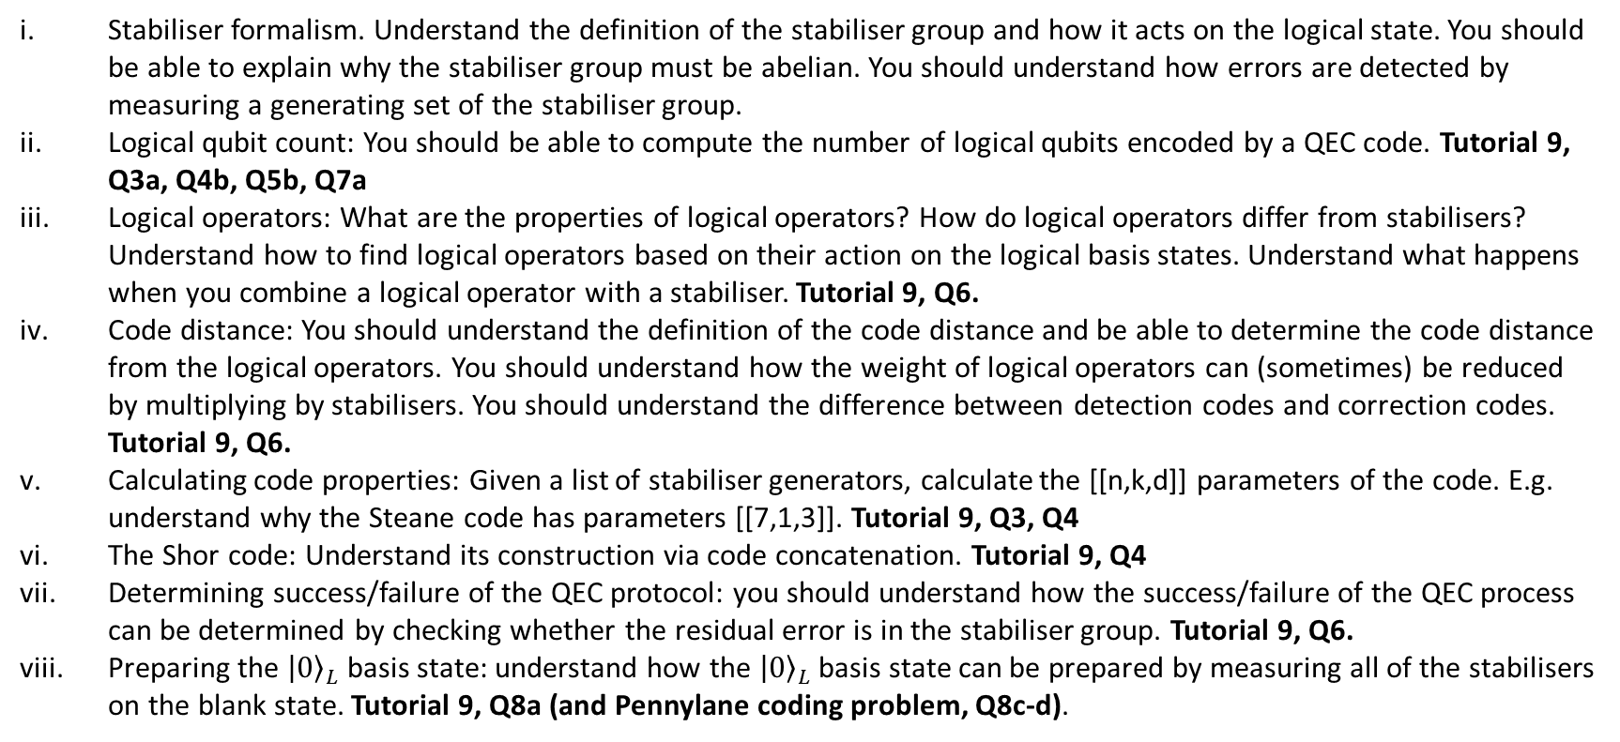
Lecture 28 | The Stabiliser Formalism | Need-to-Know
Stabiliser formalism. Understand the definition of the stabiliser group and how it acts on the logical state. You should be able to explain why the stabiliser group must be abelian. You should understand how errors are detected by measuring a generating set of the stabiliser group.
Logical qubit count: You should be able to compute the number of logical qubits encoded by a QEC code. Tutorial 9, Q3a, Q4b, Q5b, Q7a
Logical operators: What are the properties of logical operators? How do logical operators differ from stabilisers? Understand how to find logical operators based on their action on the logical basis states. Understand what happens when you combine a logical operator with a stabiliser. Tutorial 9, Q6.
Code distance: You should understand the definition of the code distance and be able to determine the code distance from the logical operators. You should understand how the weight of logical operators can (sometimes) be reduced by multiplying by stabilisers. You should understand the difference between detection codes and correction codes. Tutorial 9, Q6.
Calculating code properties: Given a list of stabiliser generators, calculate the [[n,k,d]] parameters of the code. E.g. understand why the Steane code has parameters [[7,1,3]]. Tutorial 9, Q3, Q4
The Shor code: Understand its construction via code concatenation. Tutorial 9, Q4
Determining success/failure of the QEC protocol: you should understand how the success/failure of the QEC process can be determined by checking whether the residual error is in the stabiliser group. Tutorial 9, Q6.
Preparing the ${\left|0\right\rangle }_{L}$ basis state: understand how the ${\left|0\right\rangle }_{L}$ basis state can be prepared by measuring all of the stabilisers on the blank state. Tutorial 9, Q8a (and Pennylane coding problem, Q8c-d).

Slide 7
IQC Revision
Lecture 29 – Surface Codes

Slide 8
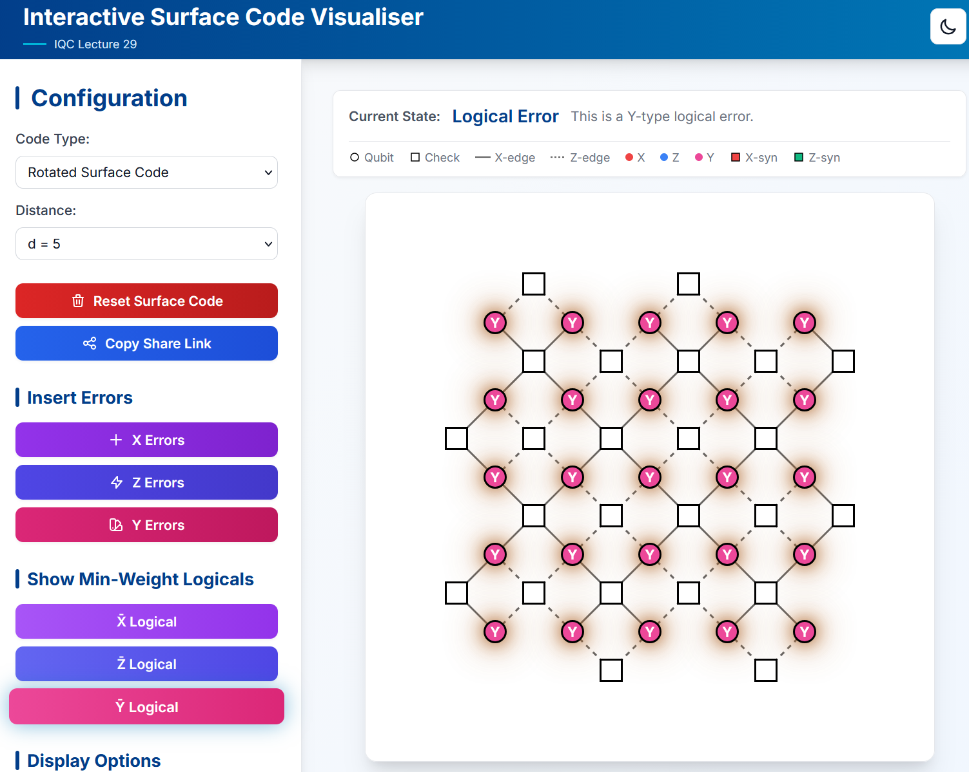
Lecture 29 | Surface Codes | Need-to-Know
Calderbank-Shor-Steane (CSS) Code: What is a CSS code?
Quantum Tanner graphs. Understand how the Tanner graph can represent a quantum error correction circuit. Given a Tanner graph, you should be able to write all the stabiliser generators of the code. Tutorial 9, Q5.
Surface codes: understand how the construction guarantees that all the stabiliser generators commute.
Understand the behaviour of X- and Z-type error chains in the surface code.
Rotated surface codes. Understand the construction and how it scales. Tutorial 9, Q7
Logical operators: You should be able to identify logical operators in the surface code (and rotated surface code) and understand why the surface code distance is equal to the width/height of the lattice. Tutorial 9, Q5f, Q7b
You should also be able to identify minimal weight logical operators of type X, Y, and Z in both the surface code and the rotated surface code. Tutorial 9, Q5f. Also, see the surface code visualiser for examples of minimal logical operators of type X, Y, Z. in the (rotated) surface code. E.g. see this example for the rotated code 👉

Slide 9

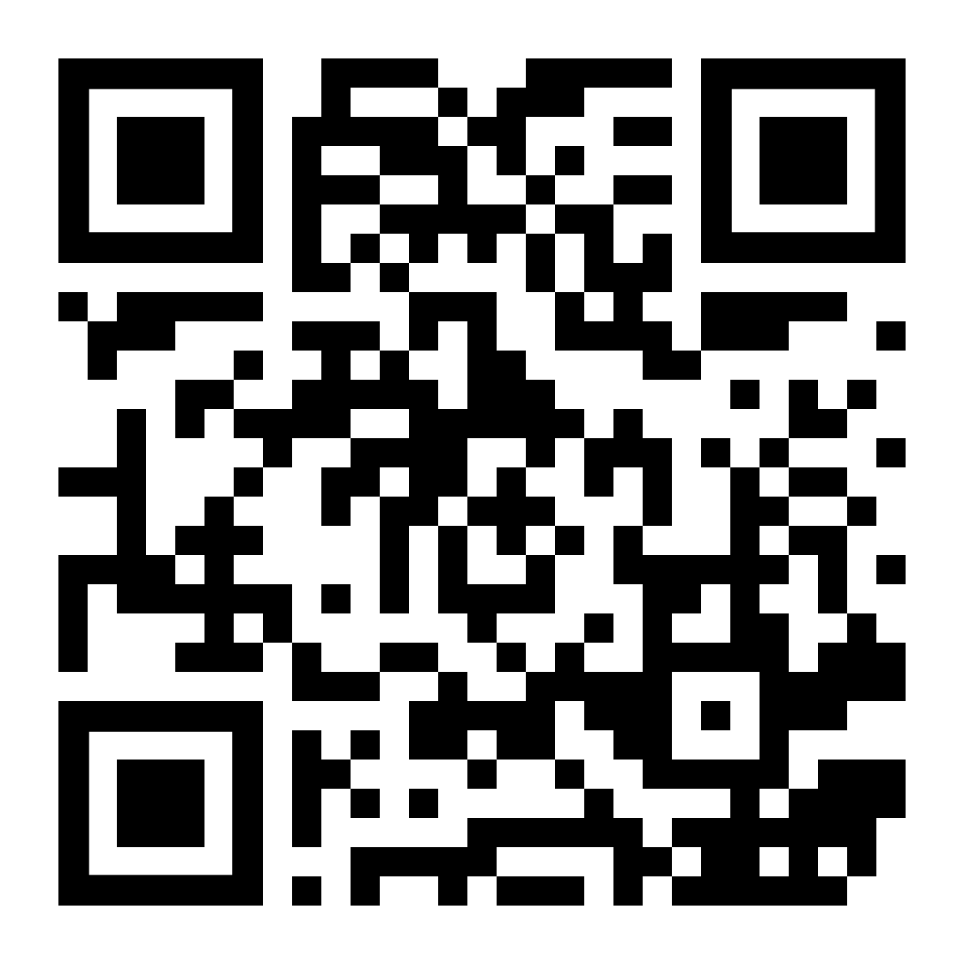
Want to join the quantum revolution?
Apply for our new Centre for Doctoral Training in Quantum Informatics
We are recruiting 16 PhD students to start September 2026.
Positions are fully funded for 4 years.
Project opportunities in a wide range of topics in quantum computing (including quantum error correction).
Contact me (joschka.roffe@ed.ac.uk), Chris, Raul or Petros if you have any questions.

